Slide 1
ANNUAL MEETING
RERC on Technologies for Children with Orthopedic Disabilities
NIDRR H133E100007
Program Director: Gerald F. Harris, Ph.D., P.E.
Program Co-Director: Li-Qun Zhang, Ph.D.

Slide 2
A Closer View – Update on Development Project, D1
D1: Developing a Pivoting-Sliding Elliptical Machine to Improve Neuromuscular Control and Stability in Axial and Frontal Planes for Children with Orthopedic Disabilities
Dr. Li-Qun Zhang
Dr. Sang Hoon Kang

Slide 3
D1: Developing a Pivoting-Sliding Elliptical System to Improve Off-Axis Neuromuscular Control in Children with Orthopedic Disabilities
Subject population
  Cerebral Palsy (CP): 18
  Knee injuries: 18
Project goal
  Develop novel off-axis rehabilitation system to train children with severe orthopaedic disabilities

Slide 4
D1 Specific Aims
Goal:
To help children improve neuromuscular control in the off-axis (minor-axis) axial and frontal planes, related to maintaining postural stability and lateral and axial stability
Aims:
To design the pivoting and sliding elliptical rehabilitation system with integrated motivating biofeedback training games for children with orthopedic disabilities
To evaluate the off-axis training system and resulting neuromuscular control changes in terms of stability, strength, stiffness, proprioception, and reaction time in tibial rotation and mediolateral sliding

Slide 5
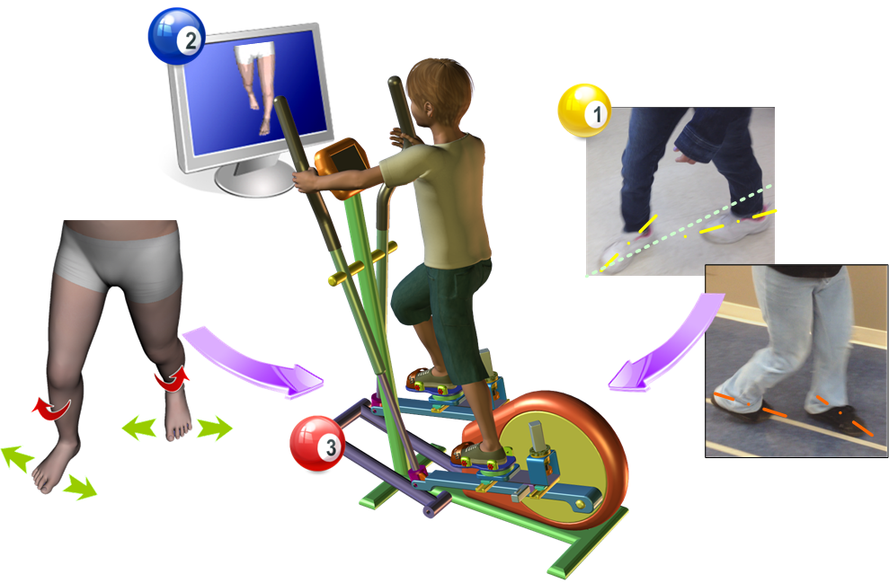
D1 Conceptual Model
Visual feedback and game guidance of 3-D motion control
Impaired motor control about the off axes (Internal/external, Mediolateral)
Robot-assisted off-axis training with assistance/resistance and quantitative outcome evaluations

Slide 6
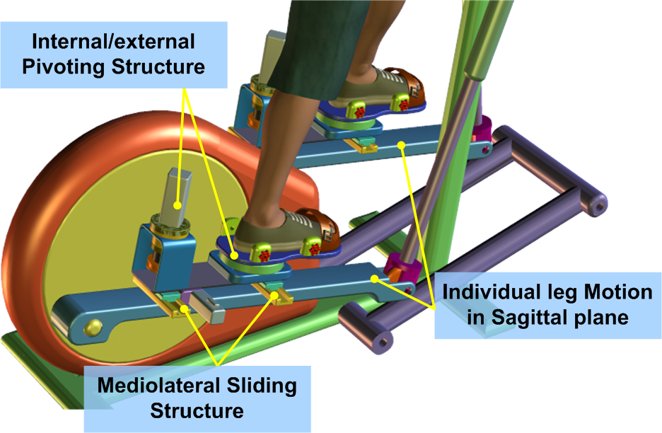
D1 Tasks
Aim1:
Task.1: Mechanical design and assembly for children
Task.2: Embedded control system and interface development
Task.3: Controllable pivoting-sliding training function design
Task.4: User-friendly software and VR-based training games
Developed features:
Provide the off-axis training motions with an controllable resistance/assistance
Improve children neuromuscular control about targeted offaxes
Provide quantitative measurements in the process.
Developed virtual reality games will motivate the children and get them more actively involved in the off-axis control training.

Slide 7
D1 Tasks
Aim2:
Task.1: Evaluate the off-axis training system
Task.2: Training-induced neuromuscular control changes
Experiment Design for Development Evaluation:
Subject Recruitment: Two groups of subjects of 36 children
(18 children with CP and 18 children with knee injuries)
Subjects in both groups will participate in the proposed training
The training involves multiple sessions (40 minutes per session, 3 sessions per week for 6 weeks) plus 6 weeks follow up
Biomechanical and clinical evaluations will be done and be compared between before and after treatments.
System performance and training outcome will be evaluated in terms of pivoting/sliding stability, muscle strength, proprioception, and reaction time to sudden perturbations and EMG signals from major leg muscles during stepping/walking movements.

Slide 8
D1 Time Line
Activity: | Year 1 | Year 2 | Year 3 | Year 4 | Year 5
Aim 1: System development
Task.1 Mechanical design and assembly
Task.2 Embedded system and Interface system development
Task.3 Design controlled pivoting-sliding training modes
Task.4 Design the user-friendly GUI and pivoting/sliding – related VR games
Publications & technology Patents
Aim 2: Clinical evaluate the off-axis training system
Task.1 Subject recruitment
Task.2 Experiment for Development Evaluation
Task.3 System and function Assessment
Publications & technology Patents

Slide 9
D1 Progress
IRB approved (STU00038747)
Number of participants to date: 6
  Awaiting testing: 2+
Developed computer control system/program and interface
Designed controllable pivoting-sliding training program
Installed video capture system and developed control program
  To assist in the off-axis control of the legs during exercise

Slide 10
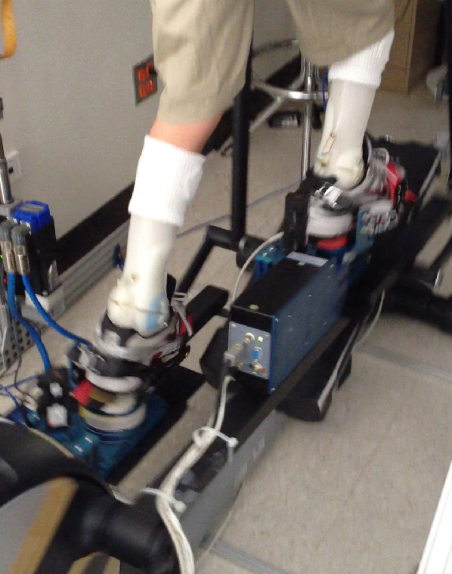
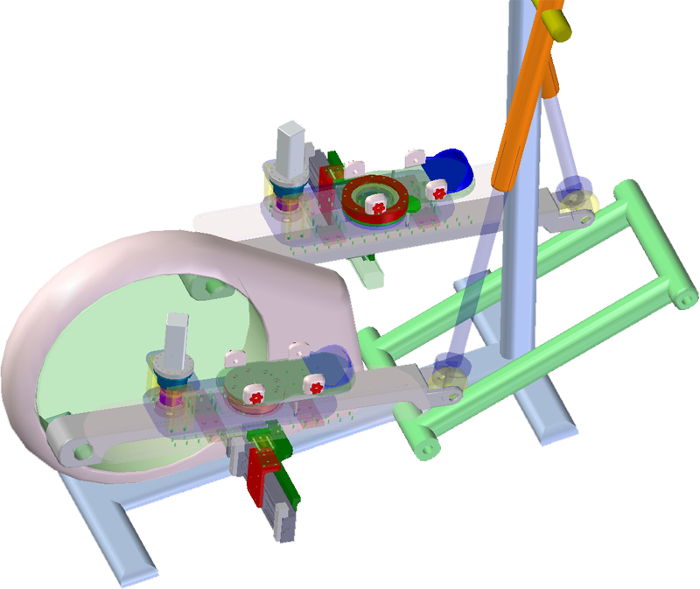
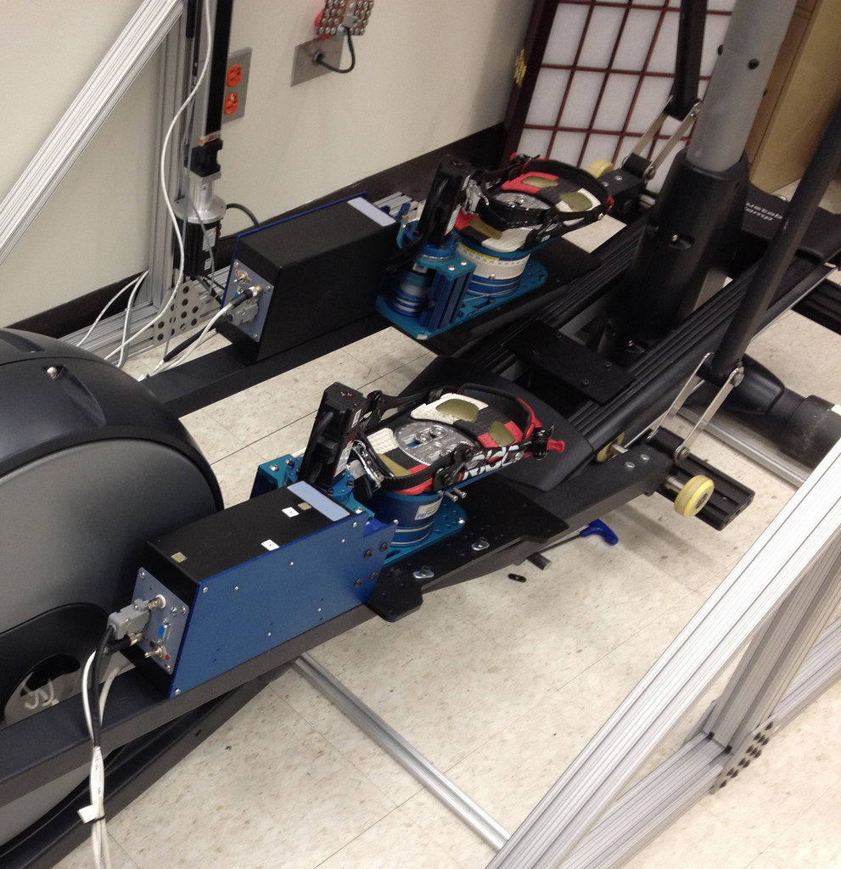
D1 Progress
Task 1: Developed the specific off-axis mechanism for children training (completed in collaboration with Rehabtek)
Including: 3D mechanical design and modeling, machining, assembling and structure testing

Slide 11
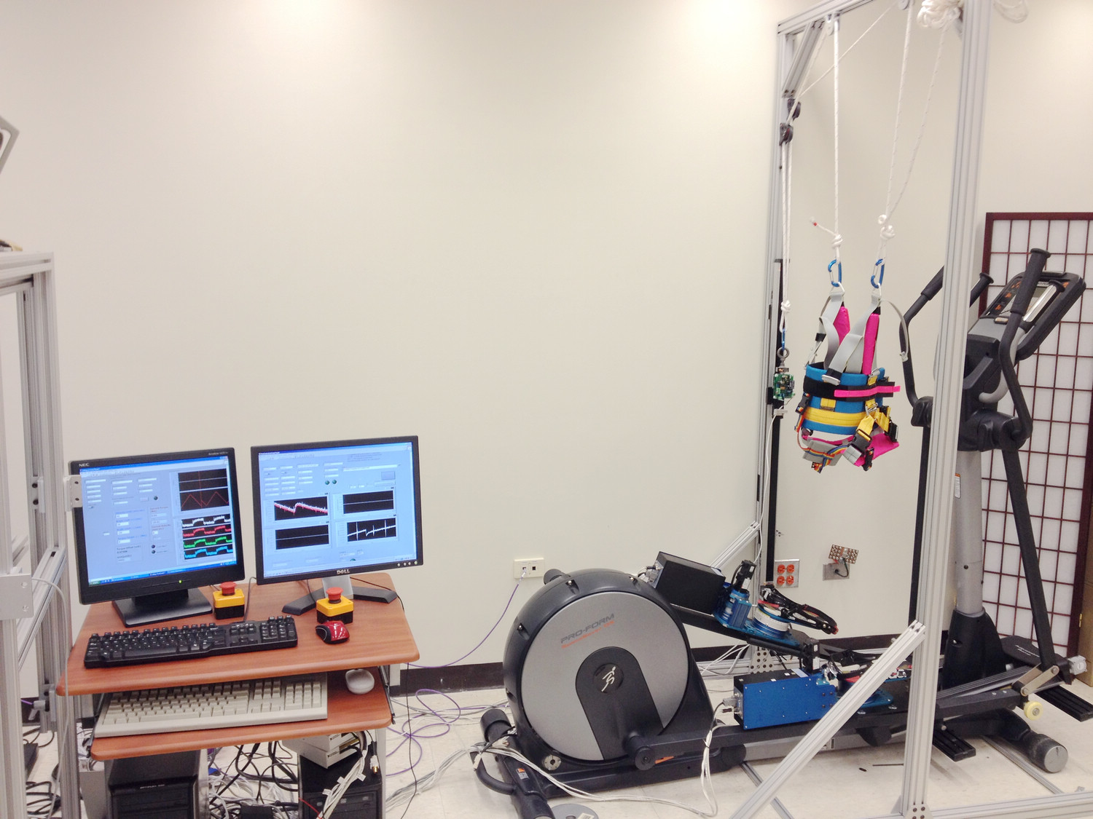
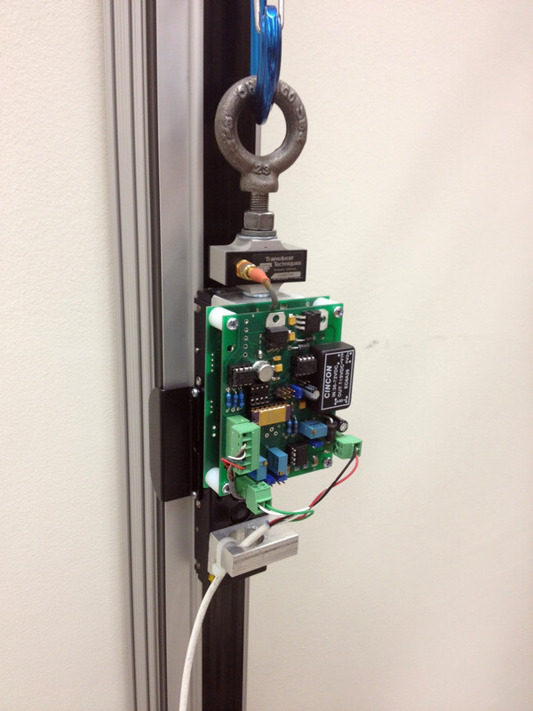
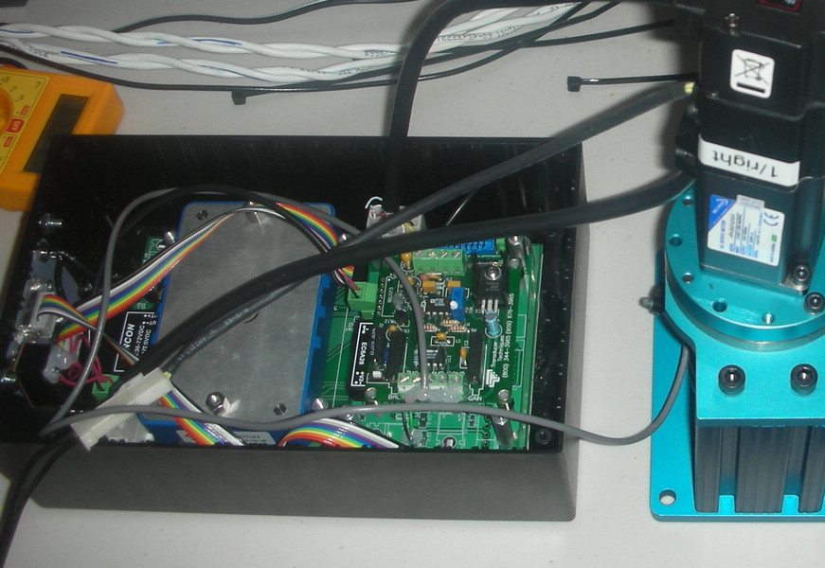
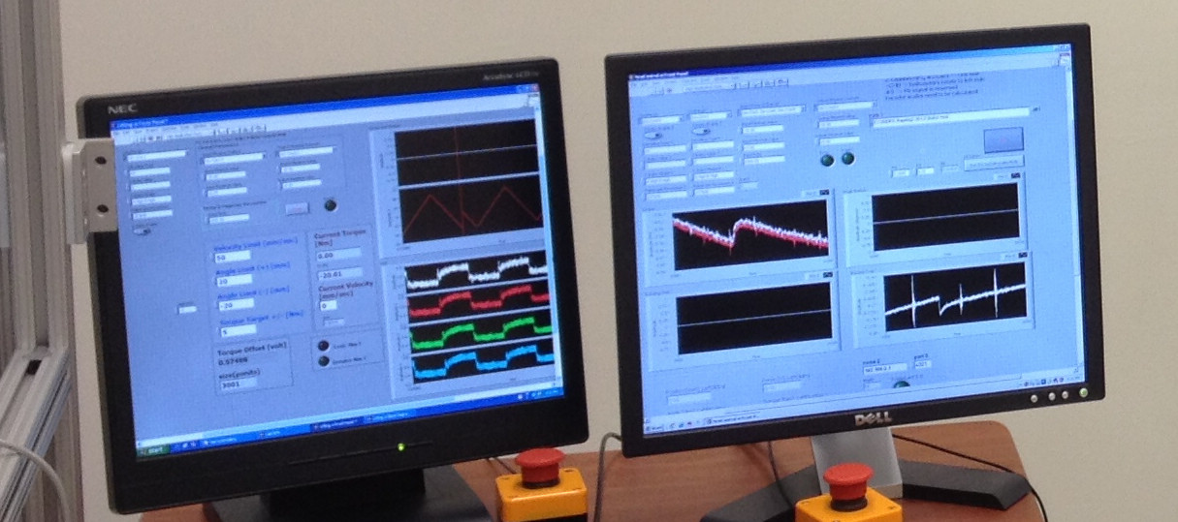
D1 Progress
Task 2: Embedded control system and interface development
Task 3: Controllable pivoting-sliding training function design
Off-axis motion
Embedded control system
Weight-support
sensing unit
Real-time control program
& DAQ system

Slide 12
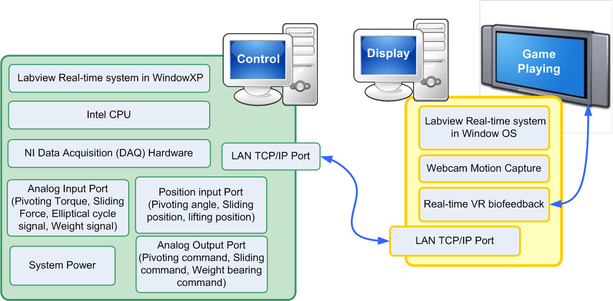
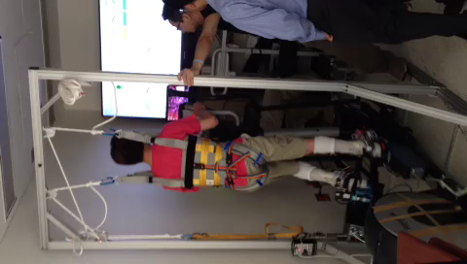
D1 Progress
Task 4 (Testing & Improving): User-friendly software and VR-based training games

Slide 13
D1 Challenges & Solution
Challenge 1: children with CP cannot stand and step if not wearing AFO
  Solution: develop controlled weight support (up to 150 lb)
Challenge 2: children with CP may not be able to stand during the entire training session
  Solution: build a cross bench/chair for resting

Slide 14
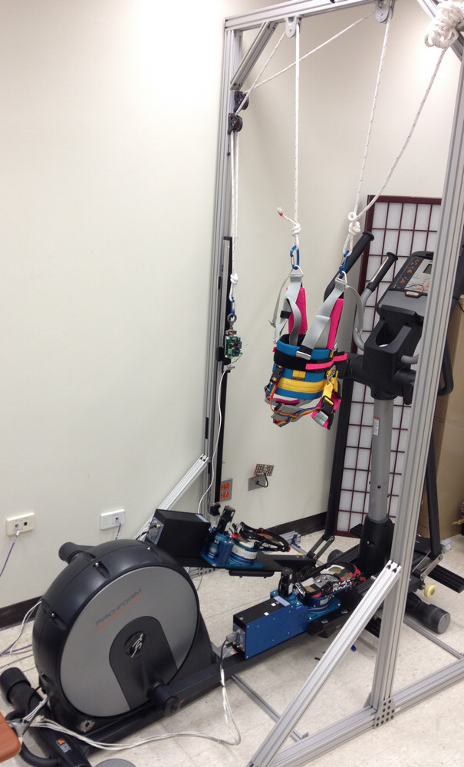
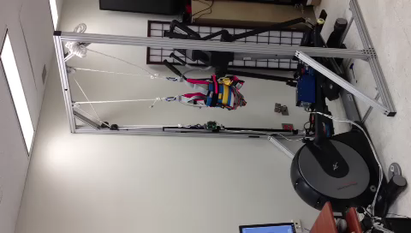
D1 Challenges & Solution
Development of a dynamic weight-support system
weight support under servomotor control
Features:
Servomotor control system
Dynamic weight bearing adjustment
More securer training system
Quantitive assessment of weight bearing change
Implement different training modes with various weight support levels
Offaxis Control

Slide 15
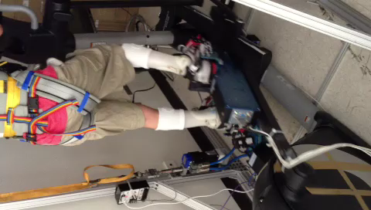
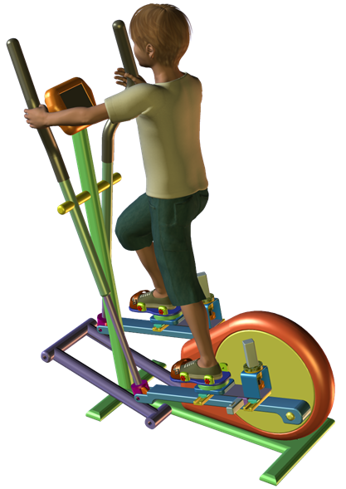

D1 Accomplishments
Accomplishments
  Embedded control system
  Assessment tool of Off-axis motion
  Training Platform of Off-axis motion
  Weight bearing system
  Potential training software packages
Prototypes/Devices
  Low-limb Training & evaluation system
  Provide the clinical tool to address impaired motion control in frontal and axial planes

Slide 16
D1 Accomplishments
Preliminary data from children with CP
After 6-week frontal plane sliding training
  On the offaxis elliptical
    Decreased instability during the free sliding condition both forwards and backwards (SD reduced from 6 to 2 mm)
    Able to abduct against greater resistances throughout the training sessions
    Step at progressively higher speeds
  Balance Scale improved from 50 to 54 (out of 56)
  Hip abduction torque increased from 7.93 to 21.96 Nm.
  Gait cadence increased from 70 to 92 steps/minute
  Section E of the GMFM improved from 97 to 100%

Slide 17
D1 Accomplishments
Preliminary data from subjects with patellofemoral pain
Evaluation of Knee Pain and Function
Off-axis control - Pivoting
Off-axis control - Sliding

Slide 18
D1 Opportunities
In clinical aspects, there is a strong need for practical and convenient rehabilitation equipment and protocol to improve off-axis lower-limb neuromuscular control and stability
It is important to develop an intervention to improve balance, muscle coordination and selective control of lower limb to improve walking ability in target population
Provide the clinical tool to solve the following questions:
How to
  Measure off-axis motion of lower limb
  Guide off-axis motion of lower limb
  Train and improve the stability of off-axis motion
  Quantitative assessment and Clinical evaluation

Slide 19
D1 Plans for Year 3
Development
  Design the user-friendly GUI
  Design pivoting/sliding – related VR games
Evaluations
  Task.1 Subject recruitment
  Task.2 Experiment for Development Evaluation
  Task.3 System and function Assessment
  Publications

