Slide 1
Update on R1-A:
Quantitative 3-D Analysis of the Canal Network in Pediatric OI Bone
John Jameson (OREC Fellow, UC Berkeley)
RERC Annual Meeting, RIC, Chicago, IL
11/13/2012
Notes:
-15 minutes for presentation & questions

Slide 2
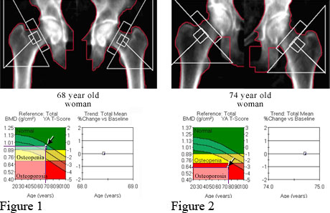
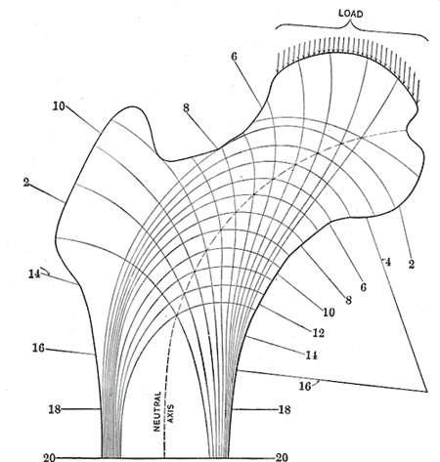
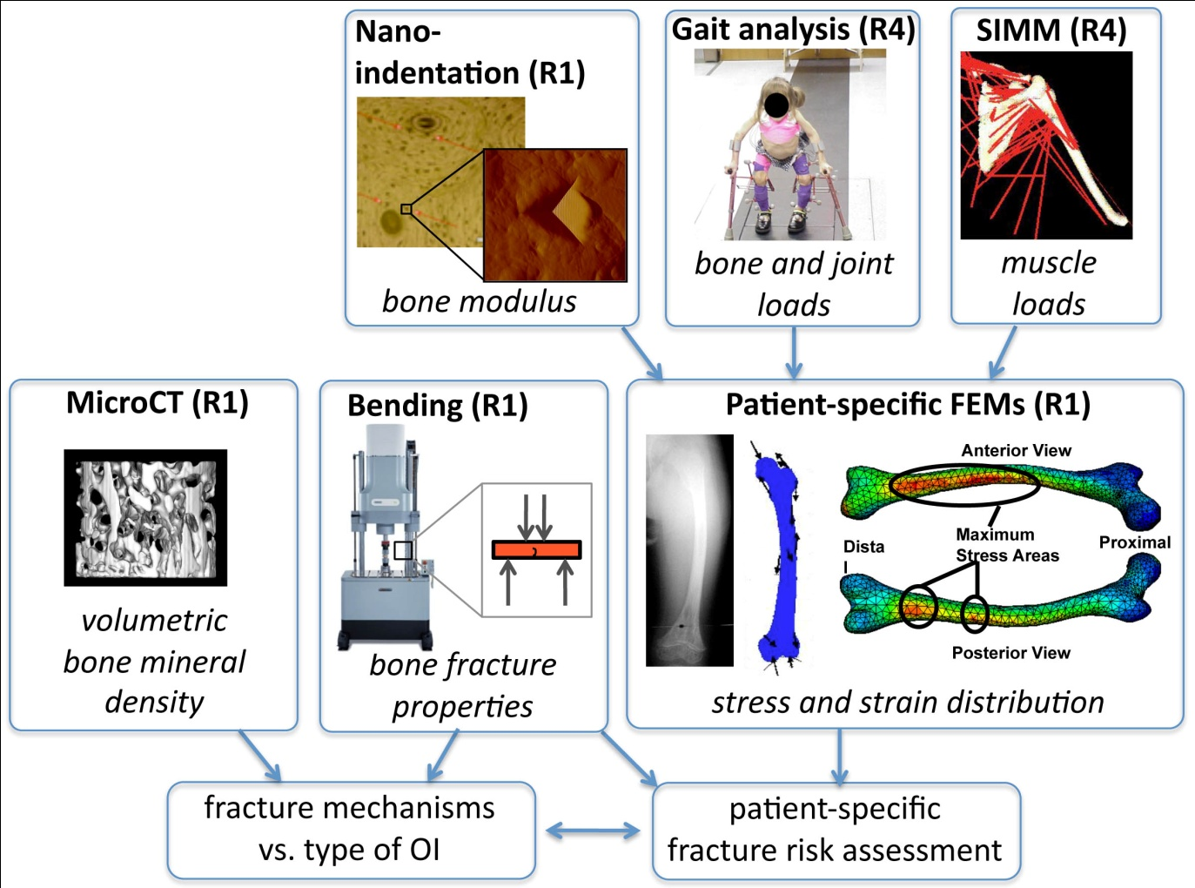

Why Study Bone Structure?...or, What Makes a Bone Strong?
Microstructure
-Bone material
-Vasculature
Mechanical Loading
-Gait Analysis
-Muscle Forces
Mineralization
-Bone Mineral Density
-Bone Mineral Content
Mechanical Properties
-Strength
-Toughness
Notes:
-My interests lie at the intersection between gait analysis, microstructural analysis, and mechanical properties

Slide 3
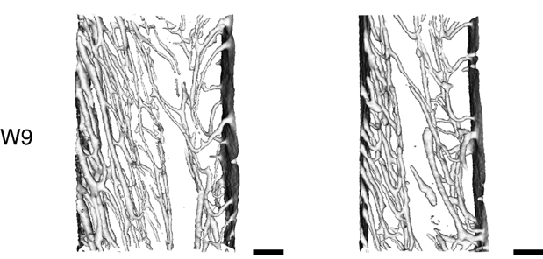
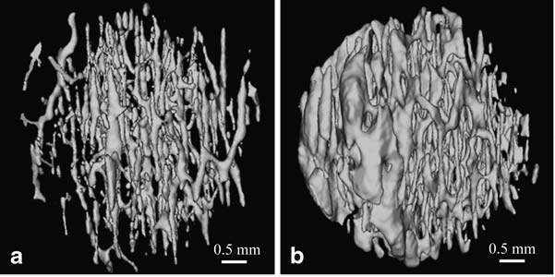
Why Study Bone Structure?
Healthy
Disuse
Rat bone:
  Matsumoto 2005 & 2007: Disuse causes decrease in porosity and connectivity without corresponding decrease in BMD
Human bone:
  Chen 2010: Cortical porosity and canal diameter increase with advanced aging
  Barth 1992: Cortical porosity and canal diameter higher in women with hip fracture
  Snyder 1992: Bone density only moderately correlated with strength!
Matsumoto et al 2007
62-yo male
92-yo male
Chen et al 2010
Notes:
1:5-10K worldwide, 25-50K US
Limb deformity, short stature, respiratory problems, hearing loss…
Type 1 most common (~50%), but least severe

Slide 4
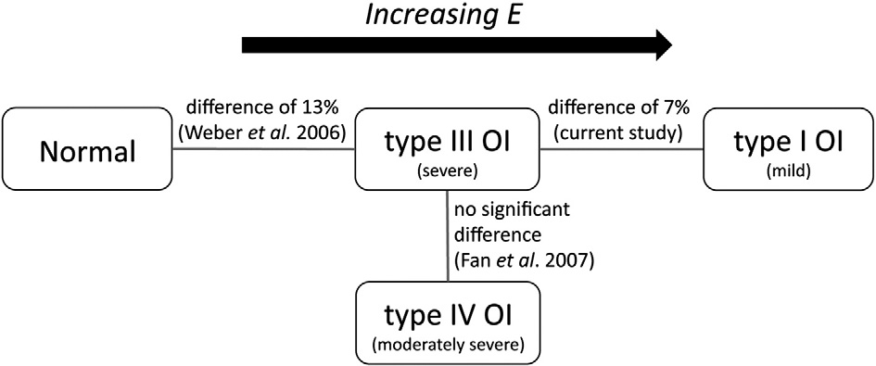
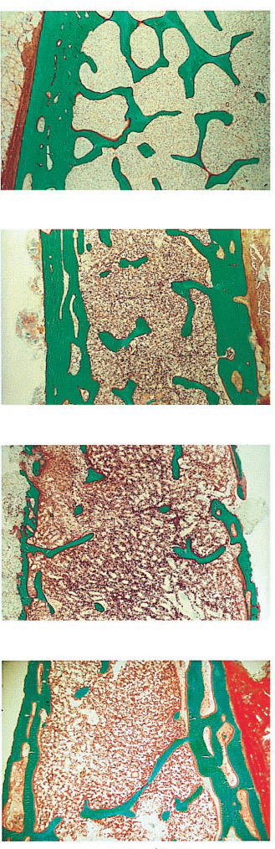
Osteogenesis imperfecta (OI)
Mechanical Loading
  Graf 2009: Increased double support, decreased ankle ROM and push-off power
Mechanical Properties
  Fan 2007, Albert 2012: Increased modulus
Bone Mineralization & Microstructure
  Boyde 1999: Increased mineralization density for all OI Types compared to controls
  Rauch 2000: Decreased cortical thickness (Ct.Th)
Albert et al 2012
C
I
Ct.Th
III
IV
Rauch et al 2000
Notes:
1:5-10K worldwide, 25-50K US
Limb deformity, short stature, respiratory problems, hearing loss…
Type 1 most common (~50%), but least severe

Slide 5


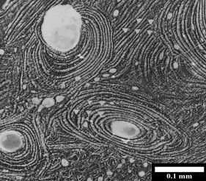
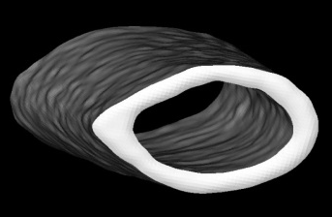
Cortical bone hierarchical structure
Fibrils
Staggered
bundles of
molecules
(~1 µm)
Collagen
Mineralized triple helices
(<1 µm)
Fiber arrays
“Plies” at different
orientations
(~5-20 µm)
Whole bone
Femur
Solid material
Cortical bone
(>3000 µm)
Osteons
Lamellae + vasculature
(100-300 µm)
Notes:
-Understanding how OI affects bone at the many different levels allows us to investigate different mechanisms that might explain the increased fragility
-Ex: Haversion and Volkman canals offer no resistance to crack growth
-Ex: Cement lines are weak interfaces between areas with different degrees of mineralization

Slide 6
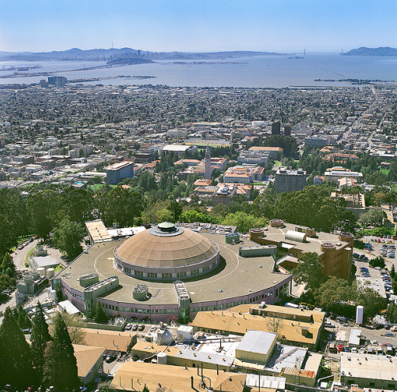
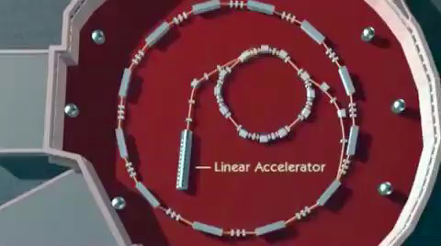
Advanced Light Source – Berkeley, CA
User facility
Electrons accelerated to 99.9999996% speed of light
Electromagnets force electrons into circular path
Advantages:
  Better contrast
  Resolution
  Composition analysis

Slide 7
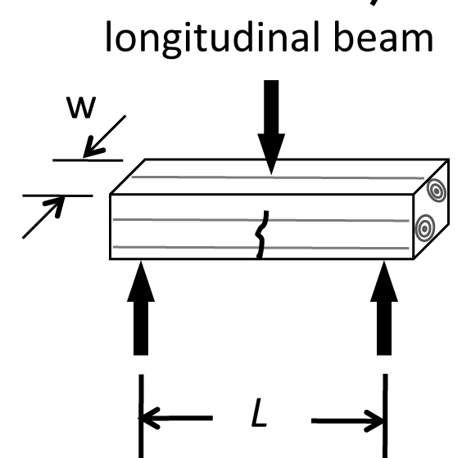
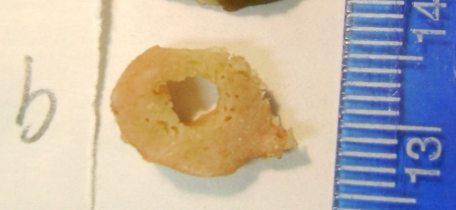
Sample prep
Surgical removal (fresh frozen)
Machining into beams
 | Age | Location | Drug History
OI (N=10) | 10.4 | Mid-diaphysis | Bisphosphonates
Type I (n=3) |  | Femur (n=4) | Pamidronate (n=6)
Type III (n=5) |  | Tibia (n=5) | Alendronate (n=1)
Type IV (n=2) |  | Humerus (n=1) | None (n=3)
Control (N=8) | 4.5 | Diaphysis | None
Healthy Pediatric |  | Femur
OI: ~1 x 0.6 x 5mm
Control: ~1 x 0.2 x 10mm

Slide 8
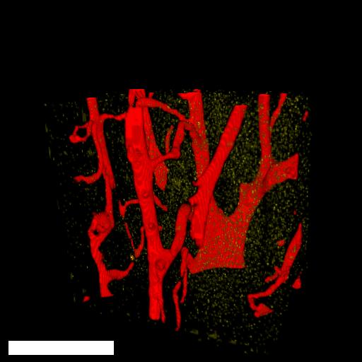
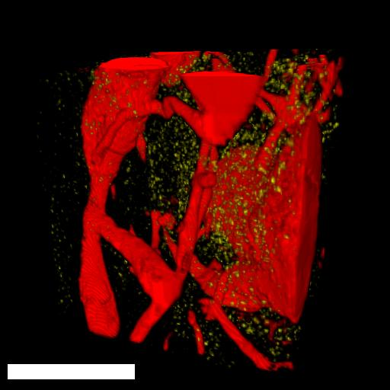
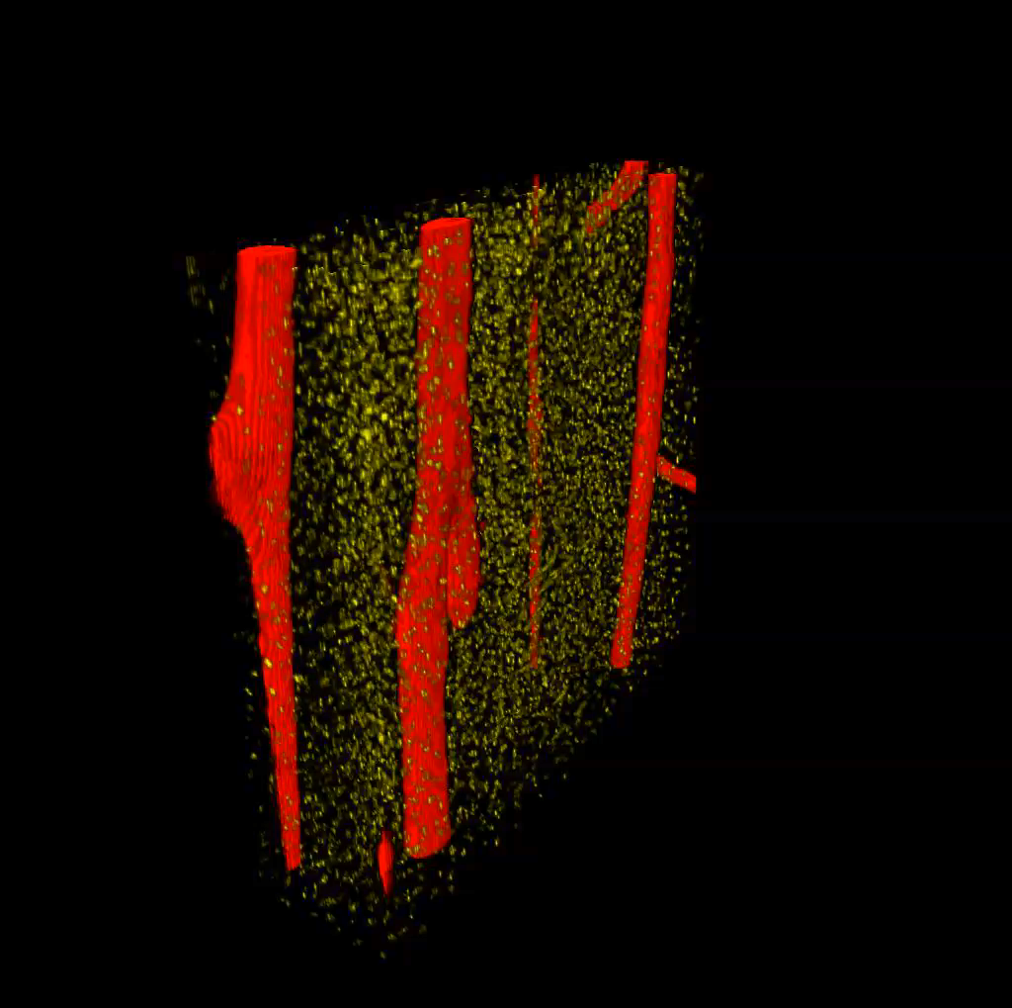
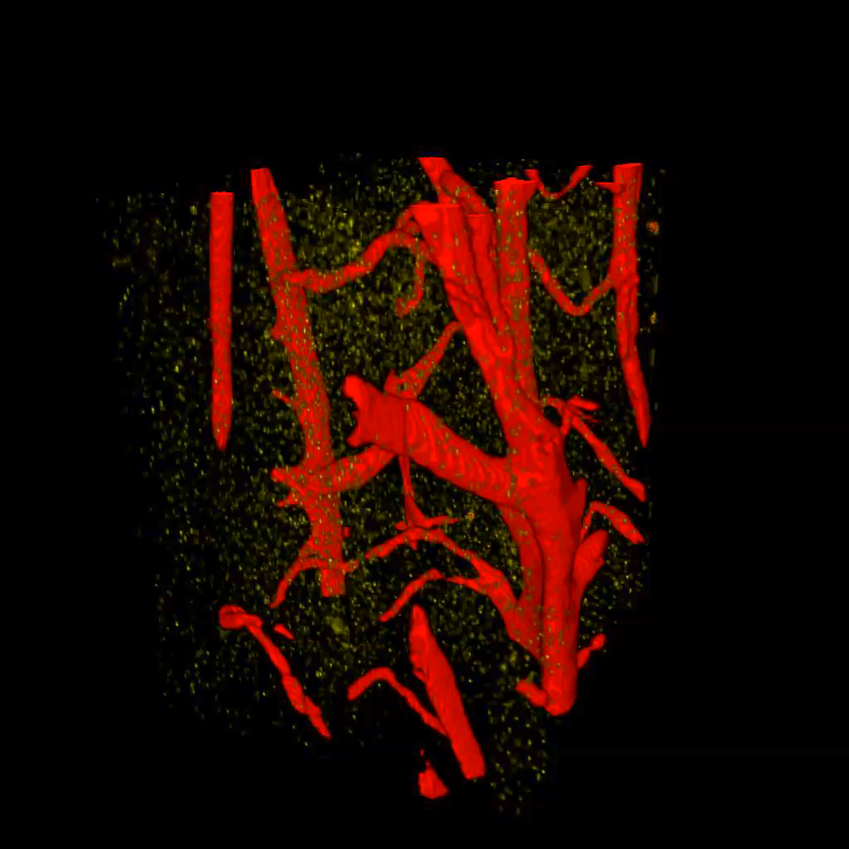
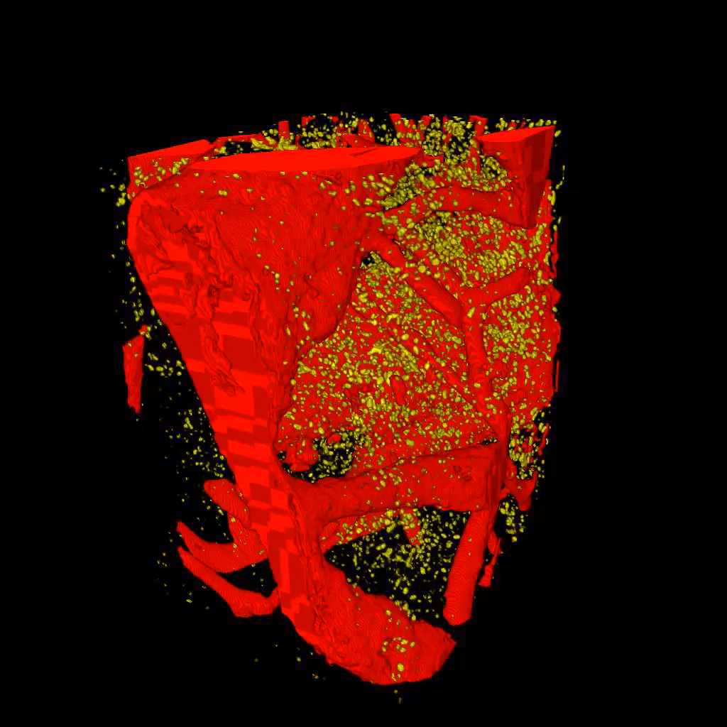
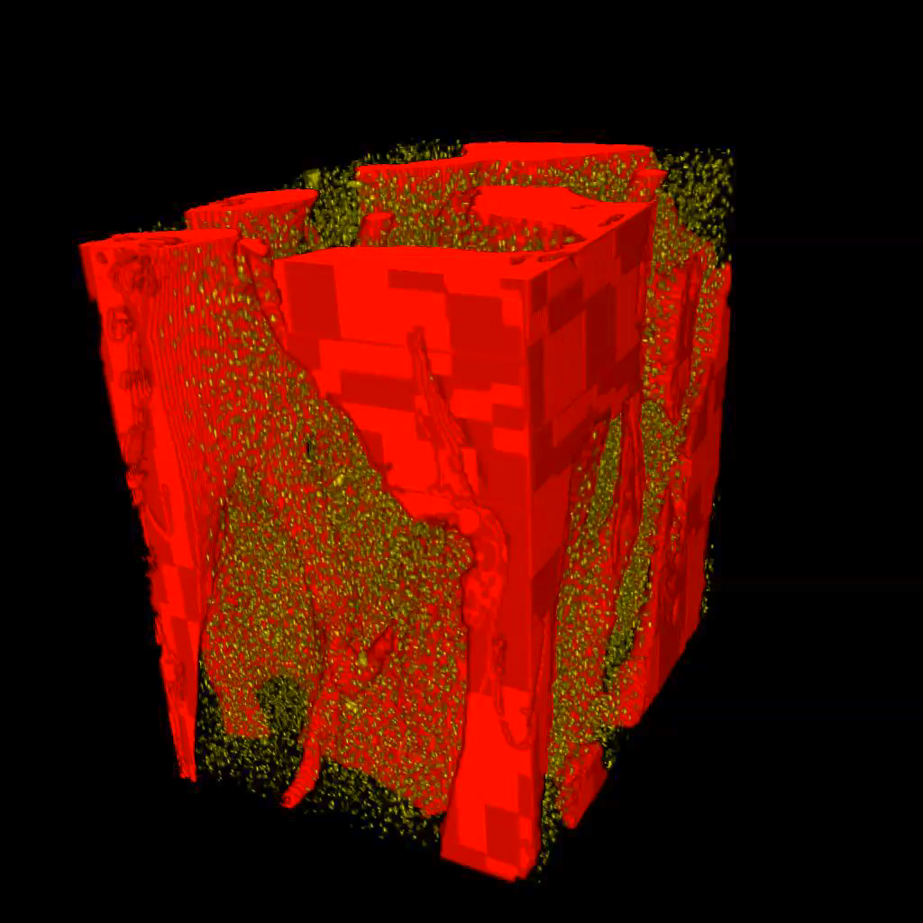
Healthy Pediatric vs. OI
Increasing porosity (Ca.V/TV), canal diameter (Ca.Dm)
Healthy Pediatric
Type IV - Moderate
Type III - Severe
Type I - Mild
 | Healthy Pediatric | OI | Significance?
Ca.V/TV (%) | 3.4 | 20.5 | P < 0.05
Ca.S/TV (mm⁻¹) | 3.1 | 6.0 | n.s.
Ca.Dm (mm) | 0.041 | 0.128 | P < 0.001
Ca.Sp (mm) | 0.177 | 0.237 | n.s.
Ca.ConnD (mm⁻³) | 8.5 | 73 | P < 0.05

Slide 9
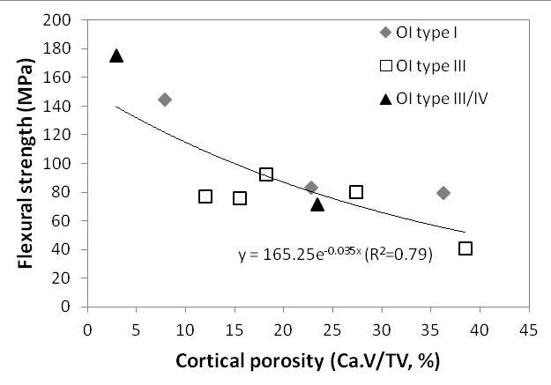
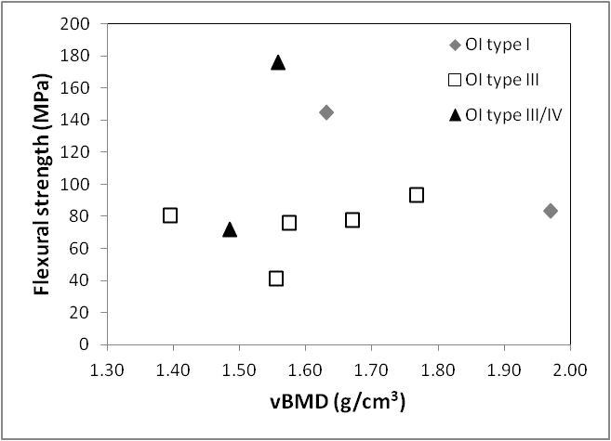
Take Home Messages
Pore structure varies significantly between healthy/OI, and possibly with OI severity
Reduction in OI bone strength can (at least partially) be explained by a dramatic increase in cortical porosity and canal diameter
  Strong correlation between porosity and flexural strength (R²=0.79)
  No apparent correlation between vBMD and flexural strength

Slide 10
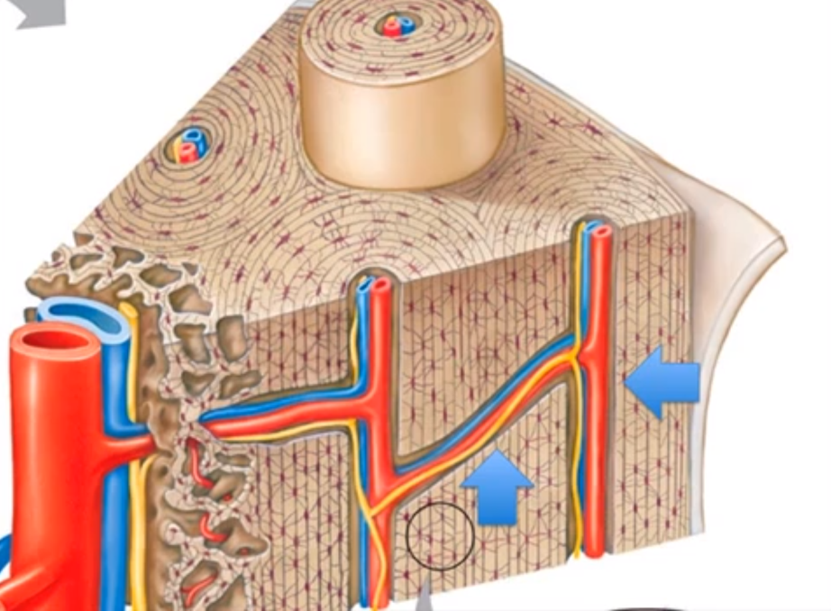
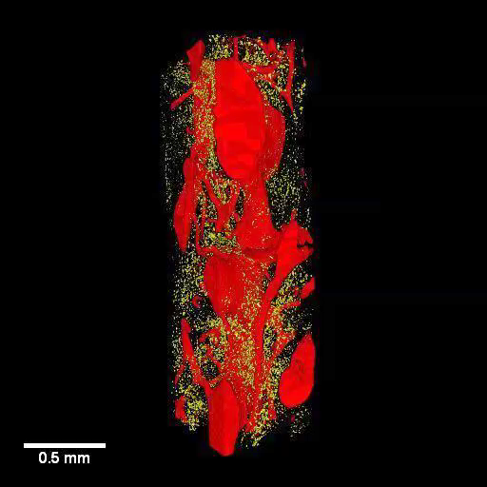
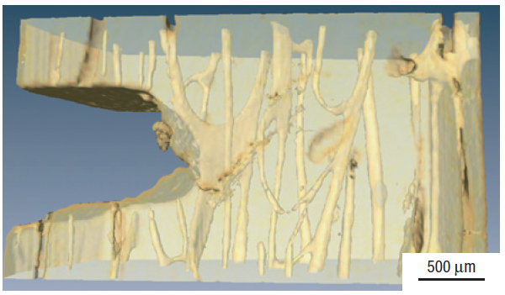
Future work:
Quantifying crack resistance
Fracture mechanics: Study of crack initiation and propagation (growth)
K_{c} – Critical “stress intensity factor”
  Ability to dissipate E before catastrophic failure (fracture)
  Increase toughness by disrupting straight crack path
    Ex: Crack deflection/twisting at central & Volkmann’s canals
Central canal
Volkmann’s canal
Crack
Canals
Koester et al 2008
Notes:
-Has the potential to improve subject-specific FE models to assess fracture risk
-Finite element solvers like Abaqus are beginning to incorporate fracture toughness into models

Slide 11
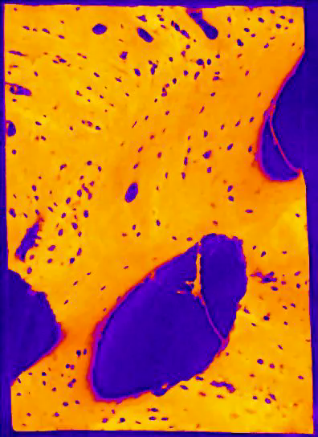
Other future applications
Effect of bone augmenting drugs
  Mineralization “mapping”
Look at degree of anisotropy
Ultrastructural studies
  SAXS/WAXD to look at collagen orientation and mineral spacing
First-order collagen peak

Slide 12
References
Matsumoto T, Yoshino M, Asano T, Uesugi K, Todoh M, Tanaka M (2006). Monochromatic synchrotron radiation uCT reveals disuse-mediated canal network rarefaction in cortical bone of growing rat tibiae. J Appl Physiol 100: p274-280.
Matsumoto T, Yoshino M, Uesugi K, Tanaka M (2007). Biphasic change and disuse-mediated regression of canal network structure in cortical bone of growing rats, Bone 41: p239-246.
Chen H, Zhou X, Shoumura S, Emura S, Bunai Y (2010). Age- and gender-dependent changes in three-dimensional microstructure of cortical and trabecular bone at the femoral neck. Osteoporos Int 21: p627-636.
Barth RW, Williams JL, Kaplan FS (1992). Osteon morphometry in females with femoral neck fractures. Clin Orthop 283: p178-186.
Snyder SM & Schneider E (1991). Estimation of Mechanical Properties of Cortical Bone by Computed Tomography. J Orthop Res 9: p422-431.
Albert C, Jameson J, Toth JM, Smith P, Harris G (in press). Bone Properties by nanoindentation in mild and severe osteogenesis imperfecta. Clinical Biomechanics. http://dx.doi.org/10.1016/j.clinbiomech.2012.10.003
Rauch F, Travers R, Parfitt AM, Glorieux FH (2000). Static and Dynamic Bone Histomorphometry in Children With Osteogenesis Imperfecta. Bone 26: p581-589.
Boyde A, Travers R, Glorieux FH, Jones SJ (1999). The Mineralization Density of Iliac Crest Bone from Children with Osteogenesis Imperfecta. Calcif Tissue Int 64: p185-190.
Koester KJ, Ager III JW, Ritchie RO (2008). The true toughness of human cortical bone measured with realistically short cracks. Nature Materials 7: p672-677.

Slide 13
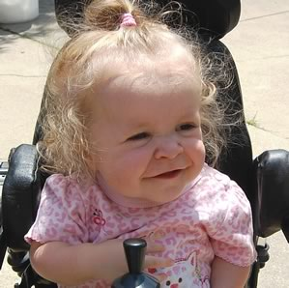
Acknowledgements
Department of Education NIDRR grants H133P080005 and H133E100007
Marquette:
  Carolyne Albert, PhD
  Robert Molthen, PhD
  Gerald Harris, PE, PhD
Shriners:
  Peter Smith, MD
  Kathy Reiners, Motion Analysis Lab Coordinator
Berkeley:
  Dula Parkinson, PhD
  Alastair MacDowell, PhD
  Rob Ritchie, PhD
  Liz Zimmerman, PhD
http://www.tech4pod.org/

