Slide 1
ANNUAL MEETING RERC on Technologies for Children with Orthopedic Disabilities NIDRR H133E100007
Program Director: Gerald F. Harris, Ph.D., P.E.
Program Co-Director: Li-Qun Zhang, Ph.D.

Slide 2
Project R2 Annual Update R2: Diffusion Tensor Imaging and Restoration of Upper and Lower Limb Function in Children with Cerebral Palsy
Dr. Brian Schmit & Dr. Michelle Johnson

Slide 3
R2A: Diffusion Tensor Imaging and Restoration of Upper and Lower Limb Function in Children with Cerebral Palsy
Cerebral Palsy (CP)
Subject population: 20 CP, 10 typical children
Overall goal
Quantitatively assess brain white matter structure (DTI and fMRI) before and after combined intervention strategies of surgery plus novel robot therapies

Slide 4
R2A Lower Extremity (LE) Hypotheses
The motor adaptations to hamstring lengthening depend on the underlying structure of the brain white matter tracts, (e.g. corticospinal tracts and thalamic radiations) as measured using DTI
fMRI measures of brain plasticity will reflect the extent of motor adaptation to hamstring lengthening transfers
Robotic interventions will accelerate fMRI changes as well as subsequent recovery of motor function

Slide 5
R2A – LE Specific Aims
Predict neural adaptations to orthopedic treatments for CP using DTI measures of brain structure
Characterize brain plasticity in response to combined orthopedic and novel robotic interventions

Slide 6
R2A – LE Procedures
Algorithm Development
Develop a voxel-wise analysis approach to characterize overall differences in brain structure.
Test approach in existing data.

Slide 7
R2A – LE Procedures
Imaging in Controls
Program Scanner for image sequence
Test scanner for image quality
Post-hoc adjustments for artifacts
Verify fMRI during pedaling
Validate DTI metrics in brain gray and white matter.

Slide 8
R2A LE Time Line
Activity: | Year 1 | Year 2 | Year 3 | Year 4 | Year 5
Adapt Imaging Techniques
Adapt Robotic Intervention Techniques
Finalize experimental set-up
Subject recruitment
Data collection in typical children
Data collection in CP children
Data Analysis
Publications

Slide 9
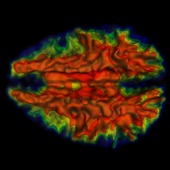
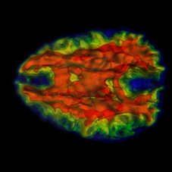
R2A – LE Progress
New Algorithm for classifying brain structure – Voxelwise Indirect Structural Connectivity

Slide 10
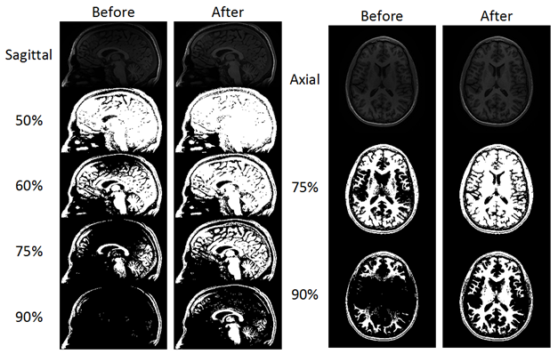
R2A LE Progress
Coil Artifact Correction

Slide 11
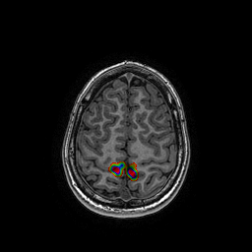
R2A - LE Progress
fMRI Validation
Able to measure fMRI during pedaling in controls

Slide 12
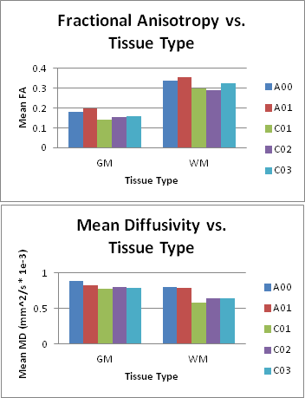
R2A LE Progress
Validation of DTI metrics in controls

Slide 13
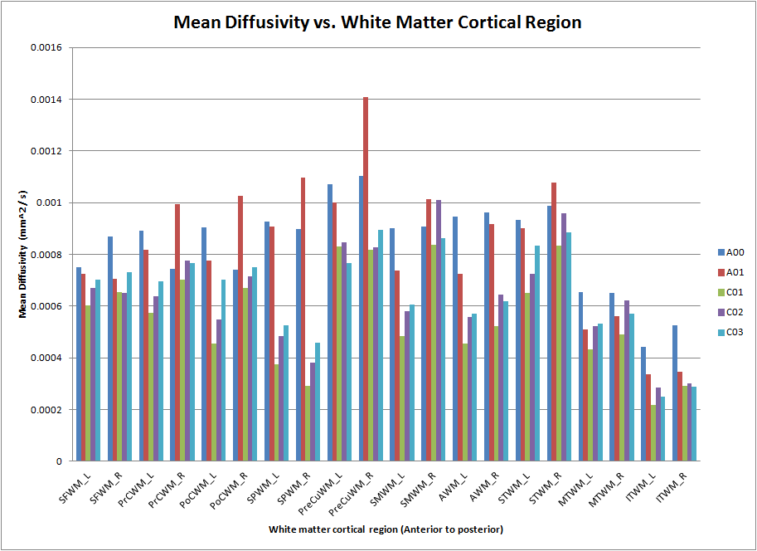
R2A LE Progress
Labeling individual white matter tracts

Slide 14
R2A LE Accomplishments
Accomplishments
Imaging techniques developed and validated
4 control subjects
Publications
Voxelwise Indirect Structural Connectivity in preparation

Slide 15
R2A LE Opportunities
Publication of control DTI and VISC in children
Use DTI to predict gait function (nonsurgical)

Slide 16
Plans for Year 3
Collect data in CP children

Slide 17
R2B: Diffusion Tensor Imaging and Restoration of Upper and Lower Limb Function in Children with Cerebral Palsy
Dr. Michelle Johnson

Slide 18
R2B: DTI and Restoration of Upper and Lower Limb Function in Children with Cerebral Palsy – Annual Report 2012
Cerebral Palsy (CP)
Subject population: 20 CP, 10 typical children
Overall goal
Quantitatively assess brain white matter structure (DTI and fMRI) before and after combined intervention strategies of surgery plus novel robot therapies

Slide 19
R2B Upper Extremity (UE) Hypotheses
The motor adaptations to wrist tendon transfers depend on the underlying structure of the brain white matter tracts, (e.g. corticospinal tracts and thalamic radiations) as measured using DTI
fMRI measures of brain plasticity will reflect the extent of motor adaptation to wrist tendon transfers
Robotic interventions will accelerate fMRI changes as well as subsequent recovery of motor function

Slide 20
R2B – UE Specific Aims
Predict neural adaptations to orthopedic treatments for CP using DTI measures of brain structure
Characterize brain plasticity in response to combined orthopedic and novel robotic interventions

Slide 21
R2B – Aim 1 UE Procedures/Tasks
Complete MRI compatible glove for children
Scan 20 Health Children
Diffusion Tensor Imaging (DTI), Spoiled Gradient Echo (SPGR), Grasp Tasks (2 trials)/Reach Tasks(2 trials)
Accomplishment: Glove Completed; 10 Healthy Child Subjects Scanned

Slide 22
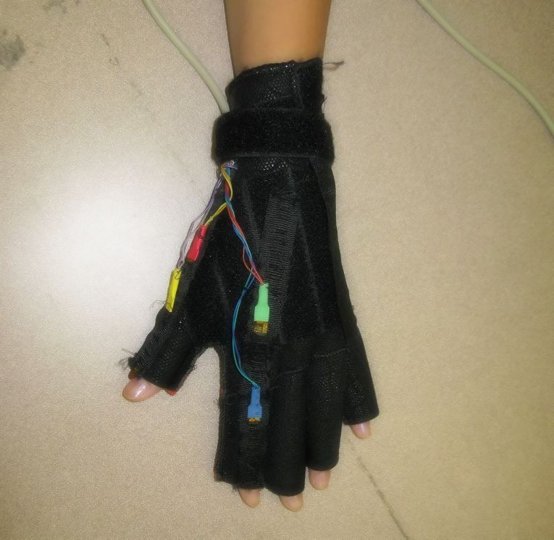
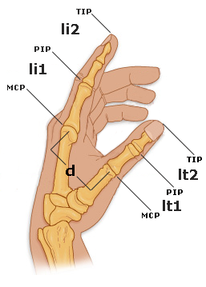
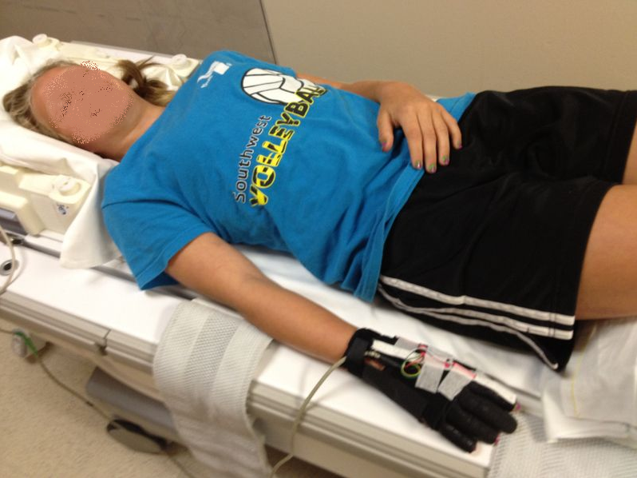
Building the Glove
I used the adult glove as reference
Learned to solder, and spliced wires
4 sensors were used to calculate grasp aperture
Subjects wore the glove, their grasp aperture was reflected as a circle
They had to close the hand to the smaller circle
sensor cable
cable strap
sensor 2
sensor 1
sensor 3
sensor 4
Finger Measurements
Notes:
Li1=Index MCP→ PIP
Li2=Index PIP→TIP
Lt1=Thumb MCP→PIP
Lt2=Thumb PIP→TIP
D=distance Index MCP→ Thumb MCP
Tip to tip is the grasp aperature

Slide 23
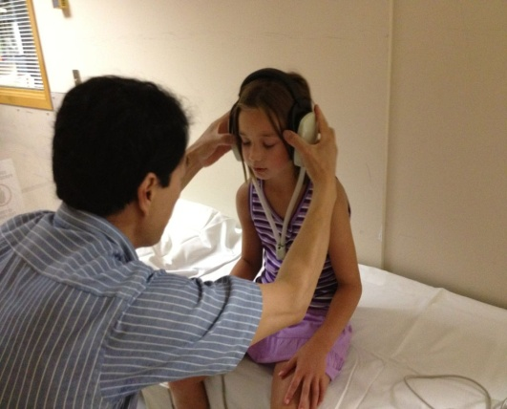
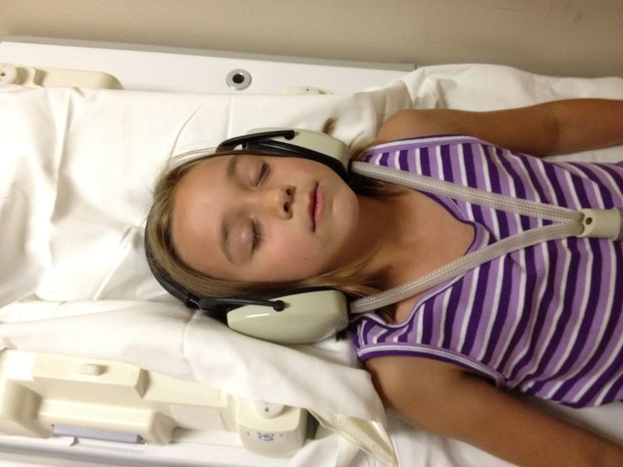
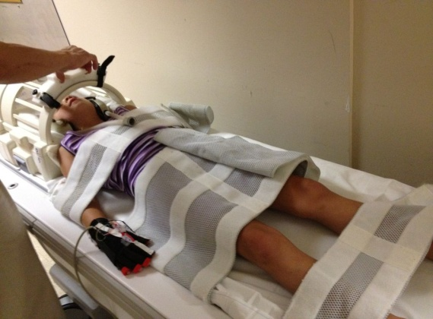
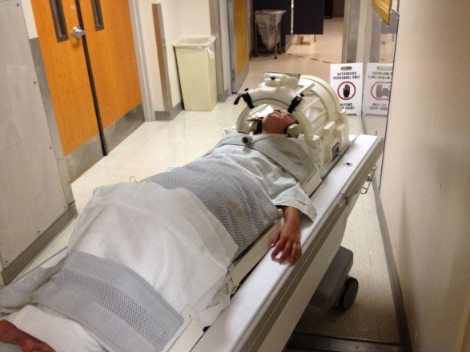
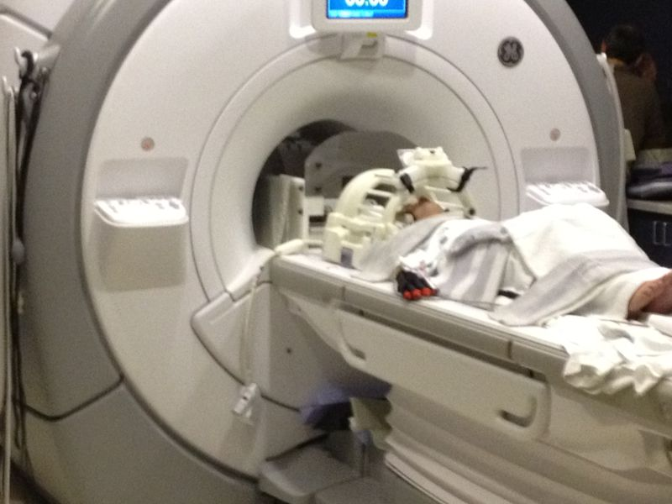
MRI Scanner
1.
2.
3.
4.
5.
Notes:
Four scans were completed in a 3.0T GE MRI Scanner
MRI is a way for us to see inside your body
The MRI we use is only for research purposes, not the kind used for diagnosis and treatment

Slide 24
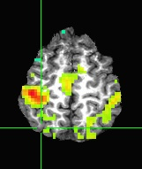
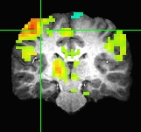
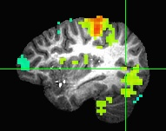
R2B – UE Preliminary Results
Analyzed 7 Children
Determined fMRI Activation
Mean activations on left in three regions were greater than on right
Mostly contralateral laterality indexes
The healthy children who used their right hand to complete the grasping tasks used the left side of their brains to execute movements

Slide 25
R2B – Aim 2 UE Procedures/Tasks
Complete Robot Hardware Design
Complete Robot Orthosis Design
Complete Robot Software and Control Program
Accomplishment: Hardware designs are completed and 90% implemented. Software designs are completed and 25% completed.

Slide 26
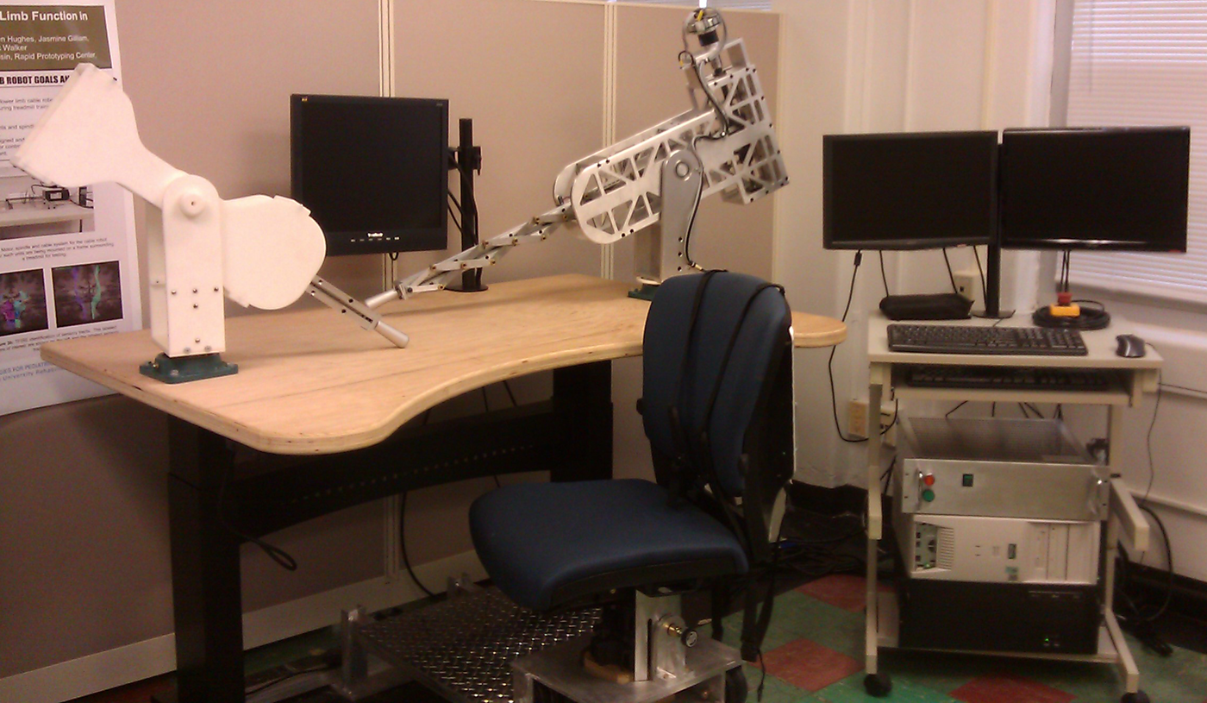
R2B - UE Robot/Orthosis
Active Robot
( for Impair arm)
Experimenter
Station
Passive follower
Robot
Target PC and
Electronic
Box

Slide 27
R2B UE Time Line
Activity: | Year 1 | Year 2 | Year 3 | Year 4 | Year 5
Adapt Imaging Techniques
Develop upper limb robot and Adapt Robotic Intervention Techniques
Finalize experimental set-up
Subject recruitment
Data collection in typical children
Data collection in CP children
Data Analysis
Publications

Slide 28
R2B UE Progress
10 typical children tested and Scanned
Next Steps:
Collect remaining 10 healthy children
Conference paper based on fMRI/DTI results
Recruit and test and train CP children

