Slide 1
ANNUAL MEETING RERC on Technologies for Children with Orthopedic Disabilities NIDRR H133E100007
Program Director: Gerald F. Harris, Ph.D., P.E.
Program Co-Director: Li-Qun Zhang, Ph.D.

Slide 2
D3: Biplanar Fluoroscopic System for Dynamic, in vivo Foot and Ankle Motion Analysis
Taly Gilat-Schmidt, Ph.D. and Janelle Cross, M.S.

Slide 3
D3: Biplanar Fluoroscopic System for Dynamic, in vivo Foot and Ankle Motion Analysis
Subject population
normal adults: 5
Project goal
Develop a biplane x-ray fluoroscopy system for analyzing in vivo motion of the bare or shod foot

Slide 4
D3 Specific Aims
To develop a prototype biplane fluoroscopy system and manual feature extraction method for in vivo studies of subtalar hindfoot kinematics

Slide 5
D3 Conceptual Model
Walkway with force plate
Bi-plane x-ray images
3D MRI images
3D Localization
X-ray sources
θ
Image Intensifiers
Milwaukee Foot Model

Slide 6
D3 Tasks
Perform phantom study to guide design of fluoroscopy system
Construct biplane fluoroscopy system
Develop geometry calibration devices and software
Implement image processing software to localize anatomy in 3D from the biplane x-ray images

Slide 7
D3 Tasks
Validate localization accuracy with dynamic phantom study
Obtain IRB approval for normal subject trial
Normal subject trial to demonstrate feasibility of kinematic and kinetic analysis in bare and shod foot

Slide 8
D3 Time Line
Activity: | Year 1 | Year 2 | Year 3 | Year 4 | Year 5
Phase 1: Phantom studies with 2D fluoroscopy system
Phase 2: Construct biplane fluoroscopy system
Phase 3: Develop feature extraction software
Phase 3: Dynamic phantom study
Phase 3: Pilot subject studies

Slide 9
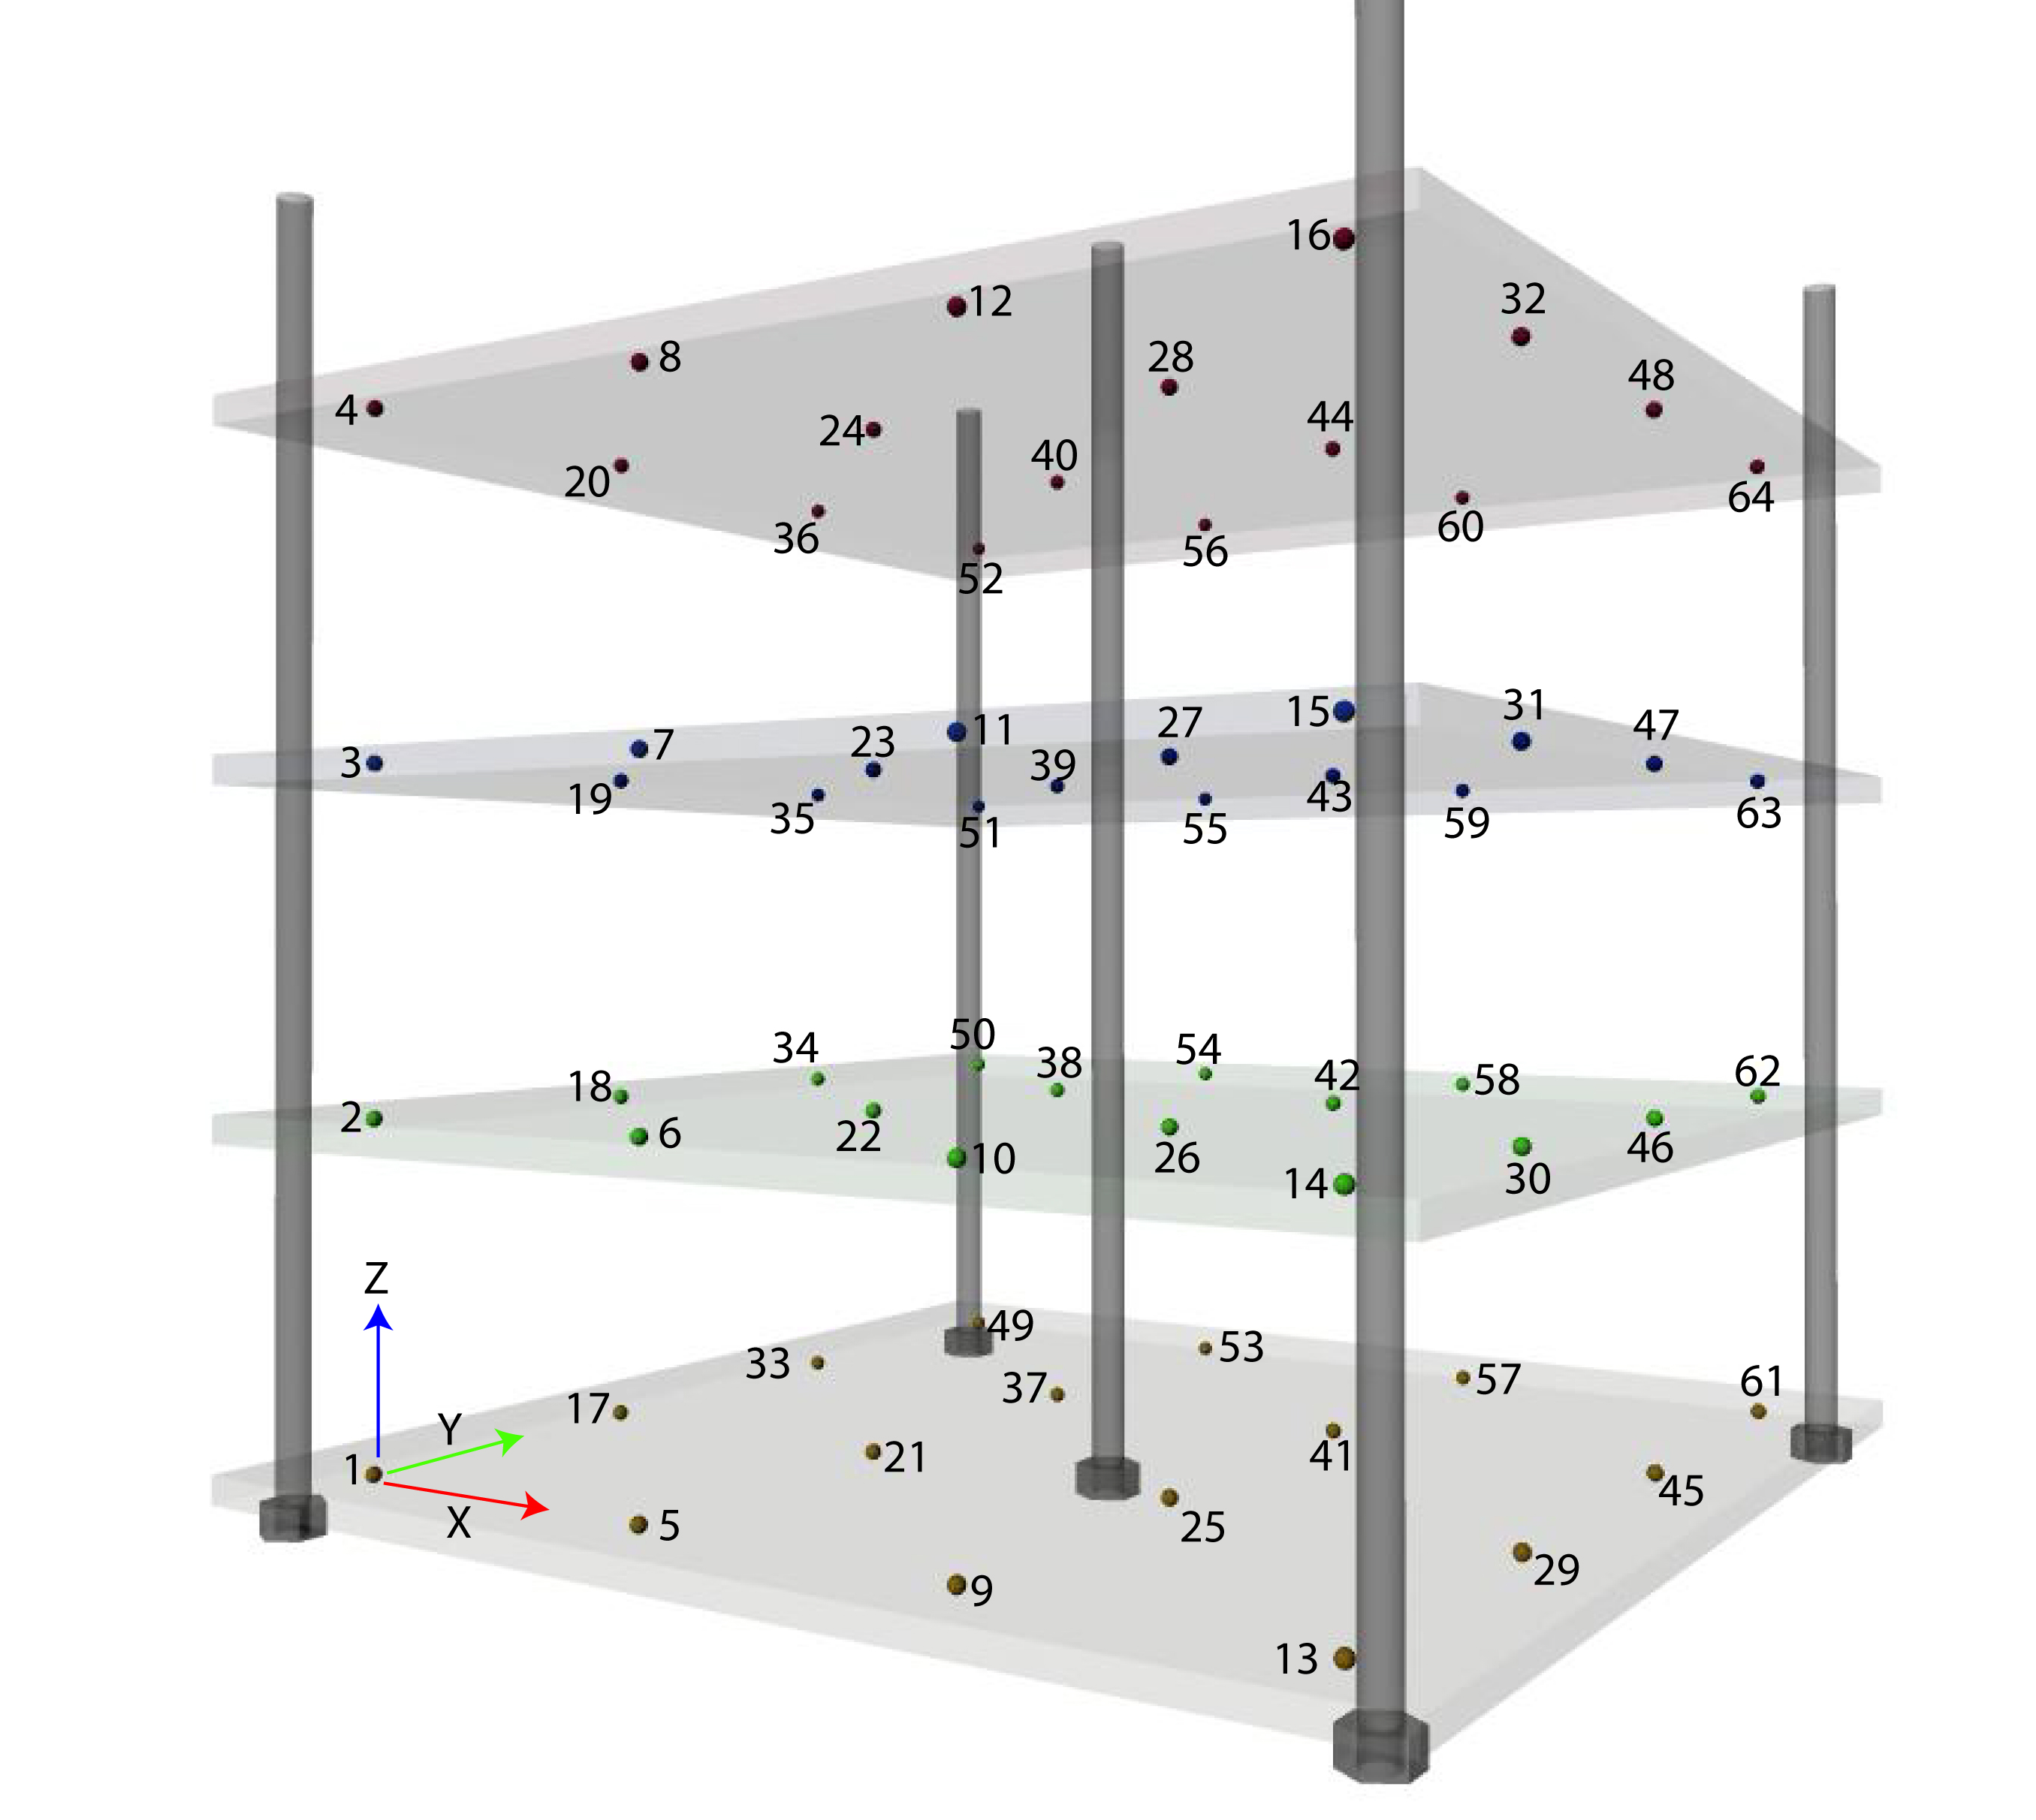
D3 Progress
Completed: Performed static phantom study
investigated fluoroscopy geometry
quantified gantry cross-contamination effects
Completed: Constructed biplane fluoroscopy system
Completed: Developed geometry calibration devices and software

Slide 10
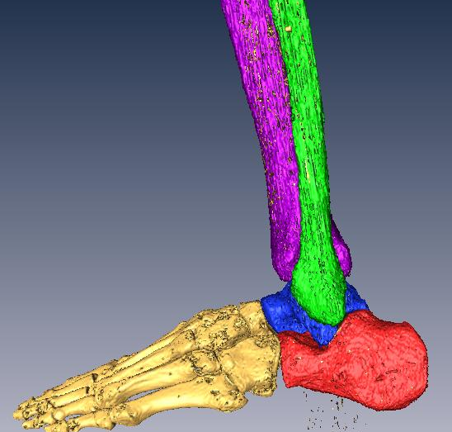
D3 Progress
In progress: Implementing image processing software to localize anatomy in 3D from the biplane x-ray images
In progress: IRB protocol submitted and undergoing review

Slide 11
D3 Accomplishments
Abstract accepted for 2013 SPIE Medical Imaging Conference:
J. A. Cross, B. McHenry, T.G. Schmidt, “Quantifying cross scatter in biplane fluoroscopy motion analysis systems.”

Slide 12
D3 Challenges & Solutions
Challenges/Solutions
Challenge: Manual feature extraction for 3D localization was too time intensive and error prone to be practical.
Solution: We evaluated and are implementing public domain software for localization through model-based tracking. Our attempt at using JointTrack was unsuccessful. We are now using Autoscoper from Brown University

Slide 13
D3 Opportunities
The image processing software we are using for localization is a conglomeration of several available software packages. A potential opportunity is to integrate these software algorithms into one package which could be disseminated
Follow-up motion analysis study for different shoe wear conditions using developed system

Slide 14
Year 3 Plans
Complete IRB approval process for normal subject trial
Normal subject trial to demonstrate feasibility of kinematic and kinetic analysis in bare and shod foot

