Slide 1
ANNUAL MEETING
RERC on Technologies for Children with Orthopedic Disabilities
NIDRR H133E100007
Program Director: Gerald F. Harris, Ph.D., P.E.
Program Co-Director: Li-Qun Zhang, Ph.D.

Slide 2
R4: Advanced Mobility Modeling to Improve Function and Longer Term Transitional Care of Children with Orthopedic Disabilities
Dr. Brooke Slavens

Slide 3
R4A: Advanced Mobility Modeling to Improve Function and Longer Term Transitional Care of Children with Orthopedic Disabilities
Proposed Subject Population of 48 Children
  Cerebral Palsy (CP): 8
  Myelomenginocele (MM): 3
  Spinal Cord Injury (SCI): 10
  Osteogenesis Imperfecta (OI): 5

Slide 4
R4 A UE Hypotheses
Proximal upper extremity joint demands are significantly greater than distal joint demands during assisted mobility in children using walkers, crutches, and wheelchairs

Slide 5
R4A UE Specific Aims
Quantify shoulder, elbow, and wrist joint dynamics during walker, crutch, and wheelchair mobility in 48 patients using 3D motion analysis and force sensing instrumented devices.
Characterize upper extremity joint loads during ambulation using a SIMM-based musculoskeletal modeling approach.
Statistically evaluate upper extremity study results using a series of data evaluation and modeling techniques. We will define the progression of joint demands and ambulatory changes associated with each patient population. Results from this project may support more effective selection of rehabilitation treatment options.

Slide 6
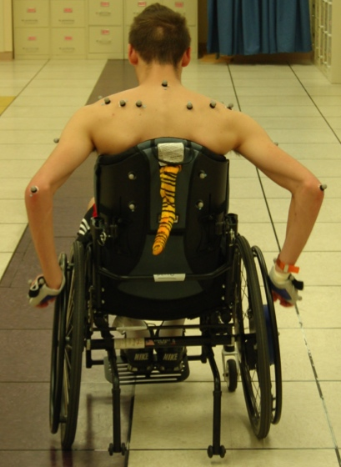
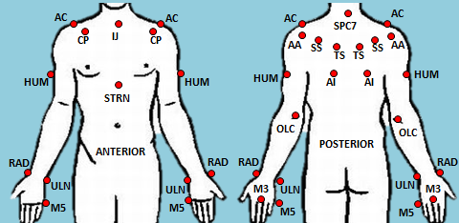
R4A UE Procedures
Design of upper extremity inverse dynamics models (kinematics and kinetics) has been completed
Subject data has been collected for 20 subjects using the inverse dynamics models and instrumented assistive devices
Kinematic and kinetic data has been processed
Outcomes assessment tools have been administered (SF-12 and VAS)

Slide 7
R4A UE Time Line
Activity: | Year 1 | Year 2 | Year 3 | Year 4 | Year 5
Technical system setup and implementation
Inverse dynamics model development, testing and integration
Subject recruitment, screening and baseline assessment
Subject testing of 48 children using assistive mobility devices
Administration and assessment of outcomes tools
Musculoskeletal model development, testing and integration
Quantitative data review, ongoing power analysis and statistical analysis
Publications

Slide 8
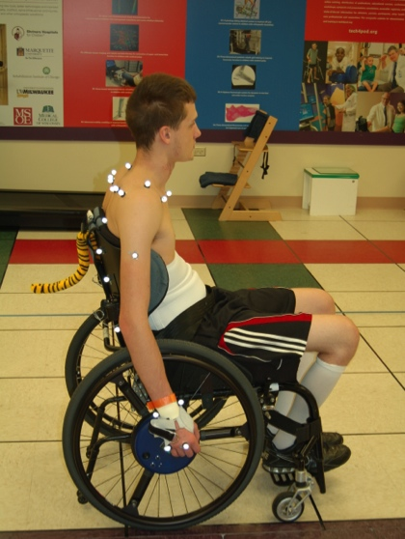
R4A UE Progress
We have tested the following subjects:
  Cerebral Palsy (CP): 8
  Myelomenginocele (MM): 3
  Spinal Cord Injury (SCI): 10
  Osteogenesis Imperfecta (OI): 5
We have tested the following assistive device users:
  Wheelchair: 6
  Walker: 8
  Crutch: 12

Slide 9
R4A UE Progress
All 3 UE models, for each assistive device, have been designed and used for subject testing
Hardware validation has been completed
Using newly updated Vicon software - Nexus
Finalizing wheelchair kinetic model
Outcomes assessment scoring methodology underway

Slide 10
R4A UE Accomplishments
Publications and Presentations
  Paul, A.J., Slavens, B., Graf, A., Krzak, J., Vogel, L., Harris G.F., Upper Extremity Biomechanical Model for Evaluation of Pediatrics with SCI during Wheelchair Activities. In Proceedings of Howard H. Steel Conference: Pediatric Spinal Cord Injuries and Dysfunction, Lake Buena Vista, FL, Nov 29 – Dec 1, 2012. [Accepted].
  Paul, A.J., Slavens, B., Graf, A., Krzak, J., Vogel, L., Harris G.F., Upper Extremity Biomechanical Model for Analysis of Children during Wheelchair Mobility. In Proceedings of 7th Annual Meeting of the SmartWheel Users Group, Wheaton, IL, September 13 – September 14, 2012.
  Paul, A.J., Slavens, B., Graf, A., Krzak, J., Vogel, L., Harris G.F., Upper Extremity Biomechanical Model for Evaluation of Pediatric Joint Demands during Wheelchair Mobility. In Proceedings of the 34th Annual Conference of the IEEE Engineering in Medicine and Biology Society, San Diego, CA, Aug 28-Sept 1, 2012.
  Slavens, B., Paul, A., Graf, A., Krzak, J., Vogel, L., Harris, G.F., Upper Extremity Kinematics in Children with Spinal Cord Injury during Wheelchair Mobility. In Proceedings of the Annual Conference of the Gait and Clinical Movement Analysis Society, Grand Rapids, MI, May 9 – May 12, 2012
  Paul, A.J., Slavens, B., Harris, G.F., Biomechanical Model of Pediatric Upper Extremity Dynamics during Wheelchair Mobility. Marquette University Graduate Day Engineering Poster Symposium, March 29, 2012
  Slavens, B., Graf, A., Krzak, J., Vogel, L., Harris, G.F., Upper Extremity Wheelchair Kinematics in Children with Spinal Cord Injury. In Proceedings of the 33rd Annual Conference of the IEEE Engineering in Medicine and Biology Society, Boston, MA, Aug 30-Sept 3, 2011.

Slide 11
R4A Challenges & Solutions
Challenges/Solutions
  Configuration of hardware/software settings with crutch system were challenging– re-validation and re-training completed
  Syncing Vicon and SmartWheel system were challenging – able to use SmartWheel software to trigger Vicon data collection
  Implementing the Vicon Nexus Software for use with current hardware set-up and familiarity with software changes – training and practice sessions were conducted

Slide 12
Plans for Year 3
Submit manuscript to Journal of Biomechanics on inverse dynamics wheelchair model
Submit short papers to GCMAS, ASIA, RESNA, WOTA, AOTA
Present accepted short paper at Howard H. Steel Conference: Pediatric Spinal Cord Injuries and Dysfunction
Present at the Annual SmartWheel User’s Group Meeting
Test an additional 16 subjects
Evaluation of outcomes assessment tools
Musculoskeletal model development
Begin statistical analyses of data
Recruit a graduate student

