Slide 1
ANNUAL MEETING RERC on Technologies for Children with Orthopedic Disabilities NIDRR H133E100007
Program Director: Gerald F. Harris, Ph.D., P.E.
Program Co-Director: Li-Qun Zhang, Ph.D.

Slide 2
R3: Home-Based Robot-Assisted Therapy and Tele-Assessment for Joint Impairment in Children with Cerebral Palsy
Dr. Li-Qun Zhang
Dr. Kai Chen

Slide 3
R3: Home-Based Tele-Assisted Robotic Rehabilitation of Joint Impairments in Children with Cerebral Palsy
Cerebral Palsy (CP)
Subject population: 48
Home based subjects: 24
Lab based subjects: 24

Slide 4
R3 Hypotheses
Combined intelligent stretching and voluntary movement training reduces ankle impairment in children with CP in terms of selected biomechanical and functional measures
Home-based rehabilitation in patients with CP will be more effective than lab-based rehabilitation in reducing ankle impairment with improved motor control in terms of the biomechanical and functional measures

Slide 5
R3 Specific Aims
Refine existing prototypes and develop a portable rehabilitation robot capable of combined passive stretching and active movement training with an integrated telecommuting interface and suitable for home- and lab-based rehabilitation of spastic ankles
Conduct 6-week home- and lab-based rehabilitation sessions of impaired ankles in children with CP using the portable tele-assissted rehab robot
Evaluate outcomes in both groups of children with CP in terms of biomechanical and functional measures, including passive and active ROMs, strength, selective motor control, balance, and mobility

Slide 6
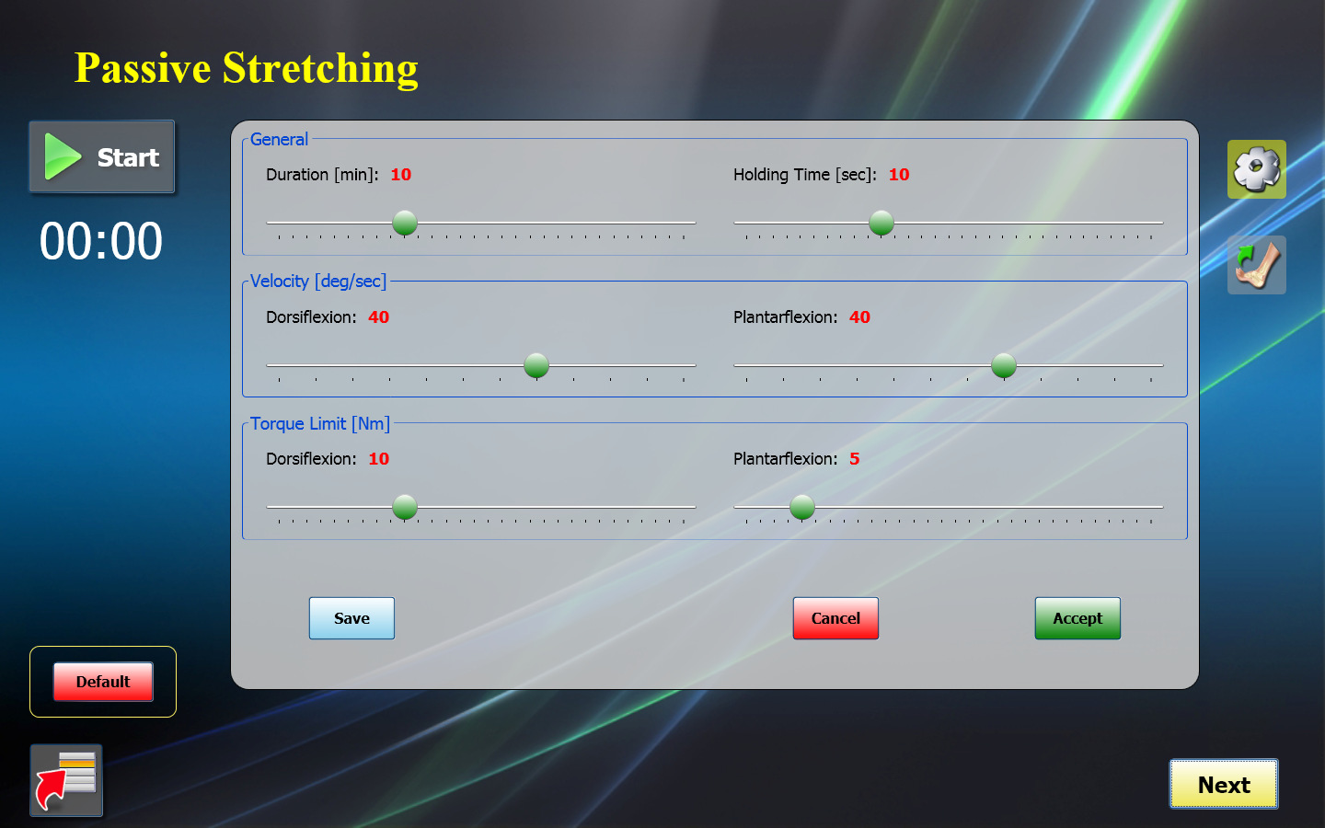
R3 Procedures
Passive Stretching : 15 minutes at beginning, 5 minute cool down after active movement training
Basic Stretching: to measure PROM
Intelligent Stretching: holds patient in dorsiflexion position for 10 seconds at a time, decreases velocity near end range

Slide 7
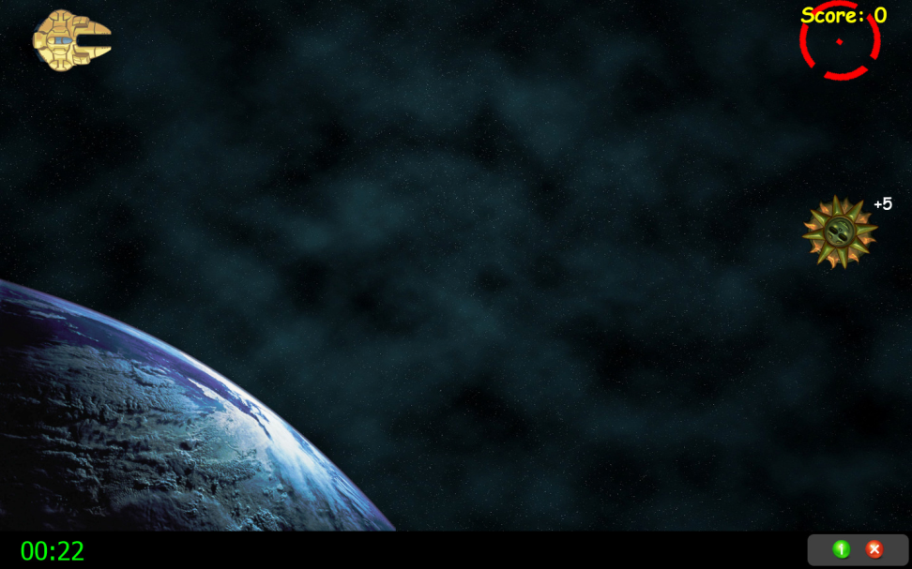
R3 Procedures
Active Exercise with visual biofeedback: 30 minutes
Assistive Exercises: if patient cannot reach target movement, device will provide assistive to help them reach desired position
Resistive Games: 100% active movement. Can provide resistance to their movement to increase muscle strength

Slide 8
R3 Procedures
Evaluation and Outcome Measurements
Before and After Training:
Clinical: PBS, SCALE, TUG, 6 minute walk
MAS
1st, 9th, & 18th Training Session:
Biomechanical & EMG
PROM, AROM, MVC, Achilles Tendon Reflex

Slide 9
R3 Time Line
Activity: | Year 1 | Year 2 | Year 3 | Year 4 | Year 5
Technical preparation of home-base robot-guided device preparation
Technical preparation of tele-assessment function and network
Subject recruitment
Evaluate the system
Data collection in control group
Data collection in study group
Data Analysis
Publications

Slide 10
R3 Progress
NU IRB approved STU00038755
Number of control group (home based group) tested to date: 13
Weekly training data teletransmission to RIC server
Completion of pre-, mid-, post- and follow up evaluations at RIC
Number of study group (lab-based group) tested to date: 8
3 times /per for 6 weeks training at RIC
Clinical evaluations
Biomechanical evaluations including pre-, mid-, post- and follow up
Video taping
Questionnaire after training
Data processed for two groups and drafting for manuscriptures
Using results of two groups to run statistical analysis

Slide 11
R3 Progress-HB
Outcome Measure | Before Training | After Training | Follow up
Modified Ashworth Scale (MAS) | Mean: 1.04 SD: 0.60 | 1.04 0.50 | 0.91 0.47
Selective Control Assessment of the Lower Extremity (SCALE) | Mean: 6.38 SD: 2.43 | 7.69 2.01 | 7.8 2.09
6 Minute Walk | Mean: 414.07 m SD: 108.31 m | 448.21 m 123.6 m | 422.05 m 125.65 m
Pediatric Balance Scale | Mean: 48.93 SD: 6.95 | 51.46 8.06 | 51 8.89
TUG | Mean: 7.65 s SD: 2.66 s | 6.74 s 3.00 s | 6.92 s 2.77 s
Common Areas of improvement:
Pediatric Balance improvements: Standing unsupported, balancing on one foot, Reach forward
SCALE selected motor control improvements: ankle dorsi flexion (sitting, standing, knee extended), knee flexion, foot/subtalar joint (STJ) rang of motion

Slide 12
R3 Progress-HB

Slide 13
R3 Accomplishments
Publications
Zhao H, Wu Y-N, Hwang M, Ren Y, Gao F, Gaebler-Spira D, Zhang L-Q. Changes of calf muscle-tendon biomechanical properties induced by passive stretching and active movement training in children with cerebral palsy. J Appl Physiol. 2011;111:435-42.
Wu, Y.-N., Hwang, M., Ren, Y., Gaebler-Spira, D. J., and Zhang, L.-Q., 2011. Combined passive stretching and active movement rehabilitation of lower-limb impairments in children with cerebral palsy using a portable robot. Neurorehab Neural Repair. 25, 378-385.
REN Y, Chen K, Liu L, Gaebler-Spira D, Zhang L-Q. A weight-bearing exerciser and method on ankle strength and functional mobility training for children with cerebral palsy. In Proceedings of the 66th Annual Meeting of AACPDM, Toronto, Canada, Sept. 12-15, 2012.

Slide 14
R3 Accomplishments
Presentations and Lectures
Traisman lecture at Lurie Children’s Hospital of Chicago, October 2012
Back to Basic – Stretching, 66th AACPDM Annual Meeting, Toronto, 9/2012
Invited talk at Physical Therapy of University of Illinois at Chicago, November 2011
Plenary speech at International Symposium on Medical Robotics, Daegu, Korea, October 2011
Invited talk at Seoul National University, Seoul, Korea, October 2011
Invited talk at Kyungpook National University, Daegu, Korea, October 2011
Invited talk at Korea University, Seoul, Korea, October 2011
Invited talk at Shengzhen Institutes of Advanced Technology, Chinese Academy of Sciences, October 2011
Invited talk at National Research Center for Rehabilitation Technical Aids, Beijing, October 2011
Two invited talks at workshop on Innovative technology assisting children with Cerebral Palsy, IEEE EMBC 2011 meeting, Boston, September 2011

Slide 15
R3 Challenges & Solutions
Challenges/Solutions
A few subjects quit in the middle of study, new subjects have been recruited to replace.
Some children took the device for home training but do not return it, probably due to their special difficult conditions
Some children subject were not cooperated in the study, extreme patience are required to handle the naughty kids
Setup the wireless EMG and goniometer system are time consuming, and EMG electrodes may also be too big for children.

Slide 16
R3 Opportunities
Opportunities
This study seeks to extend rehabilitation care beyond the hospital and bring rehabilitation service to homes to potentially benefit larger number of children with orthopedic disabilities.
A portable rehabilitation robot incorporating the latest technologies (intelligent stretching, robot-guided voluntary movement training with motivating games and tele-rehabilitation) provides convenient and cost-effective rehabilitation to children with severe orthopedic disabilities, supported by results so far.

Slide 17
R3 Plan for Year 3
Data collection in lab-based robot rehab group
Data collection in home-based robot rehab group
Data Analysis
Publications

